Slide 1
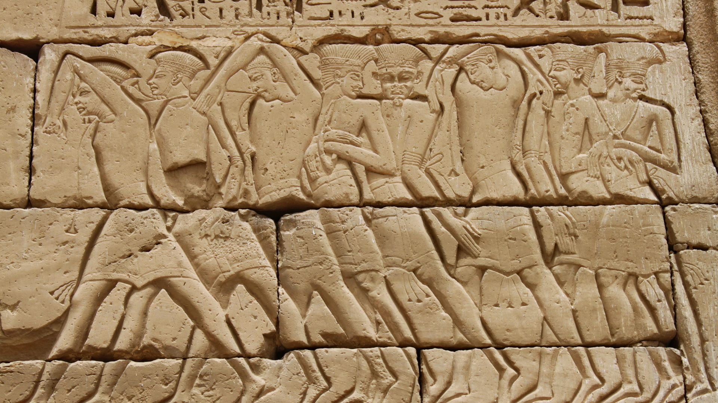
The Near East, Egypt, and Mediterranean In the Iron Age

Slide 2
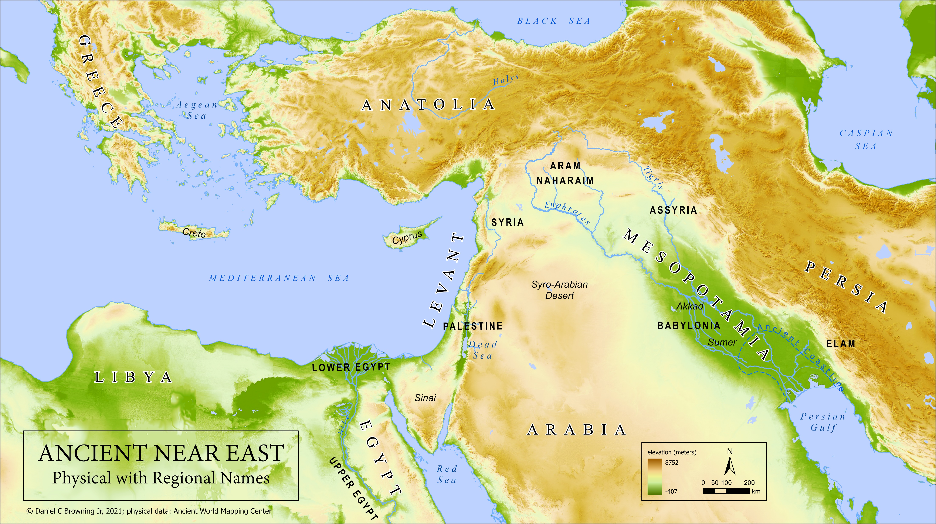

Slide 3
The Beginning of the Iron Age in
the Near East, Egypt, & E Mediterranean
(c. 1200-1000 bce)
Disappearance/Reduction of Major Powers
Loss of International Contact/Trade
  Luxury Items; women; copper & tin
Lack of Text Sources: no public monuments, archives, diplomatic letters
Rise of New National States (based on people groups)
Regional Politics and Society
Spread of New Technologies . . . Out of necessity?
  Iron tools
  Alphabetic writing
  Iron more common everywhere; but required higher smelting temp
        Simpler, easier to learn without scribal schools

Slide 4
Alphabetic Writing: A Primer
Alphabetic Writing = symbol represents basic sound of human voice
Earliest Alphabet:
  Represents a West Semitic language (like Hebrew, Aramaic, Canaanite)
  Based signs on Egyptian hieroglyphic system
  Began with informal carvings & graffiti by laypersons (not trained scribes)
First evidence from mining camps, desert wadis, Sinai
How it worked . . .

Slide 5
The Iron Age in the Near East, Egypt, & E Mediterranean
(c. 1200-333 bce)
Appox Dates bce | EGYPT | SYRIA-PALESTINE | GREECE | ANATOLIA | MESOPOTAMIA
1200-900 | Weak continuation of New Kingdom 3rd Intermediate Period Shoshenq (Shishak) I c. 925 bce | Rise of New Nations Phoenicians Philistines Arameans Moab & Edom Israel | Dark Age Migration of Greek groups | Greek Colonists in Aegean Coast Neo-Hittite States in SE | Middle Assyrian Period Neo-Hittite States in NW Rise of Aramean City-States N and NW Babylon continues in S

Slide 6
Basic Outline of Hebrew Bible History
PATRIARCHS: Abraham, Isaac, Jacob & sons (Middle Bronze Age)
SOJOURN IN EGYPT: move to Egypt under Joseph, eventual enslavement (Late Bronze Age)
EXODUS: Moses leads Israelites from Egypt, Mosaic Law at Sinai (End of Late Bronze Age)
CONQUEST: Joshua leads military invasion of Canaan, the “Promised Land” (Beginning of Iron Age)
JUDGES: Israel in tribal organization with local rule, struggle with other nations (Early Iron Age)
UNITED MONARCHY: 1st king over all Israel, Saul, superseded by David & Solomon (c. 1000-925 bc)

Slide 7
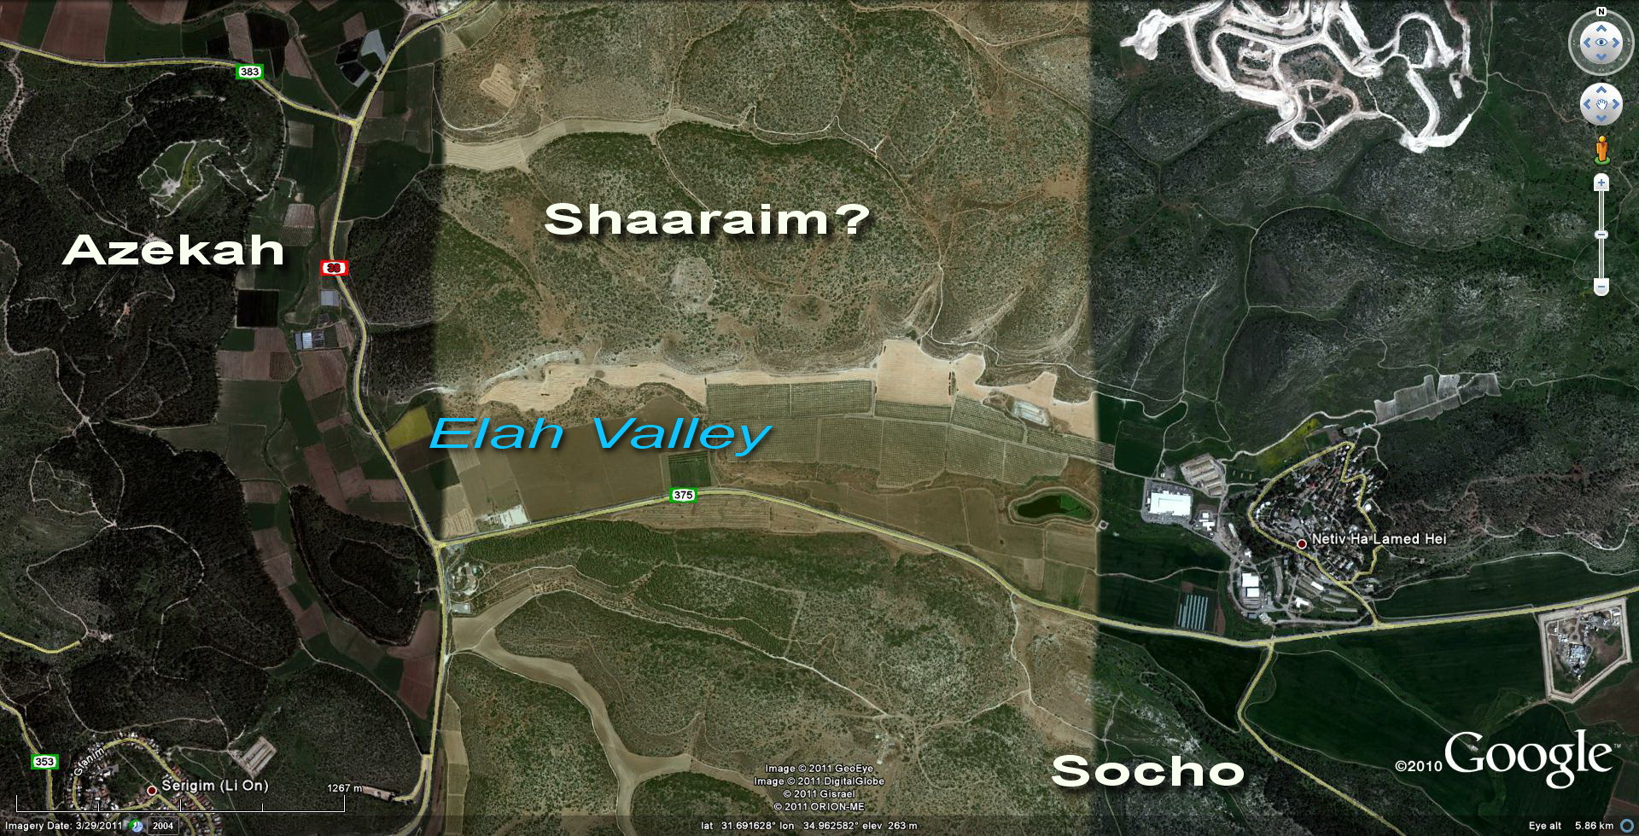

Slide 8
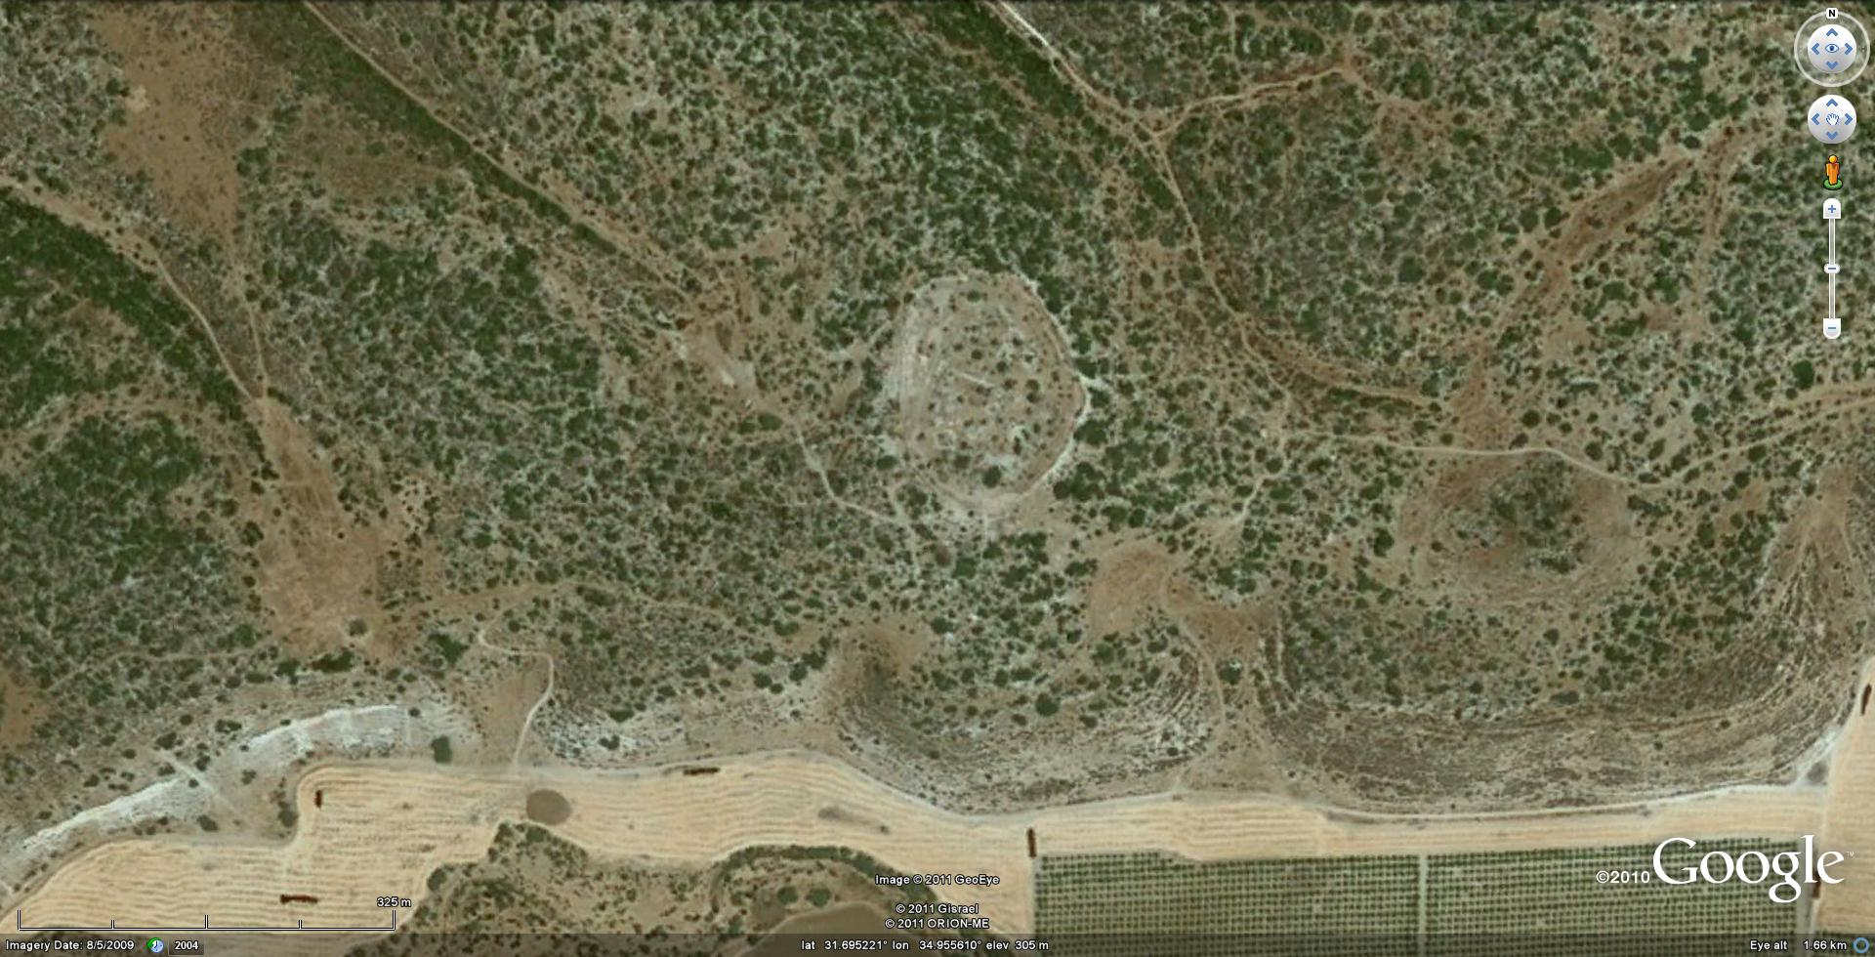

Slide 9
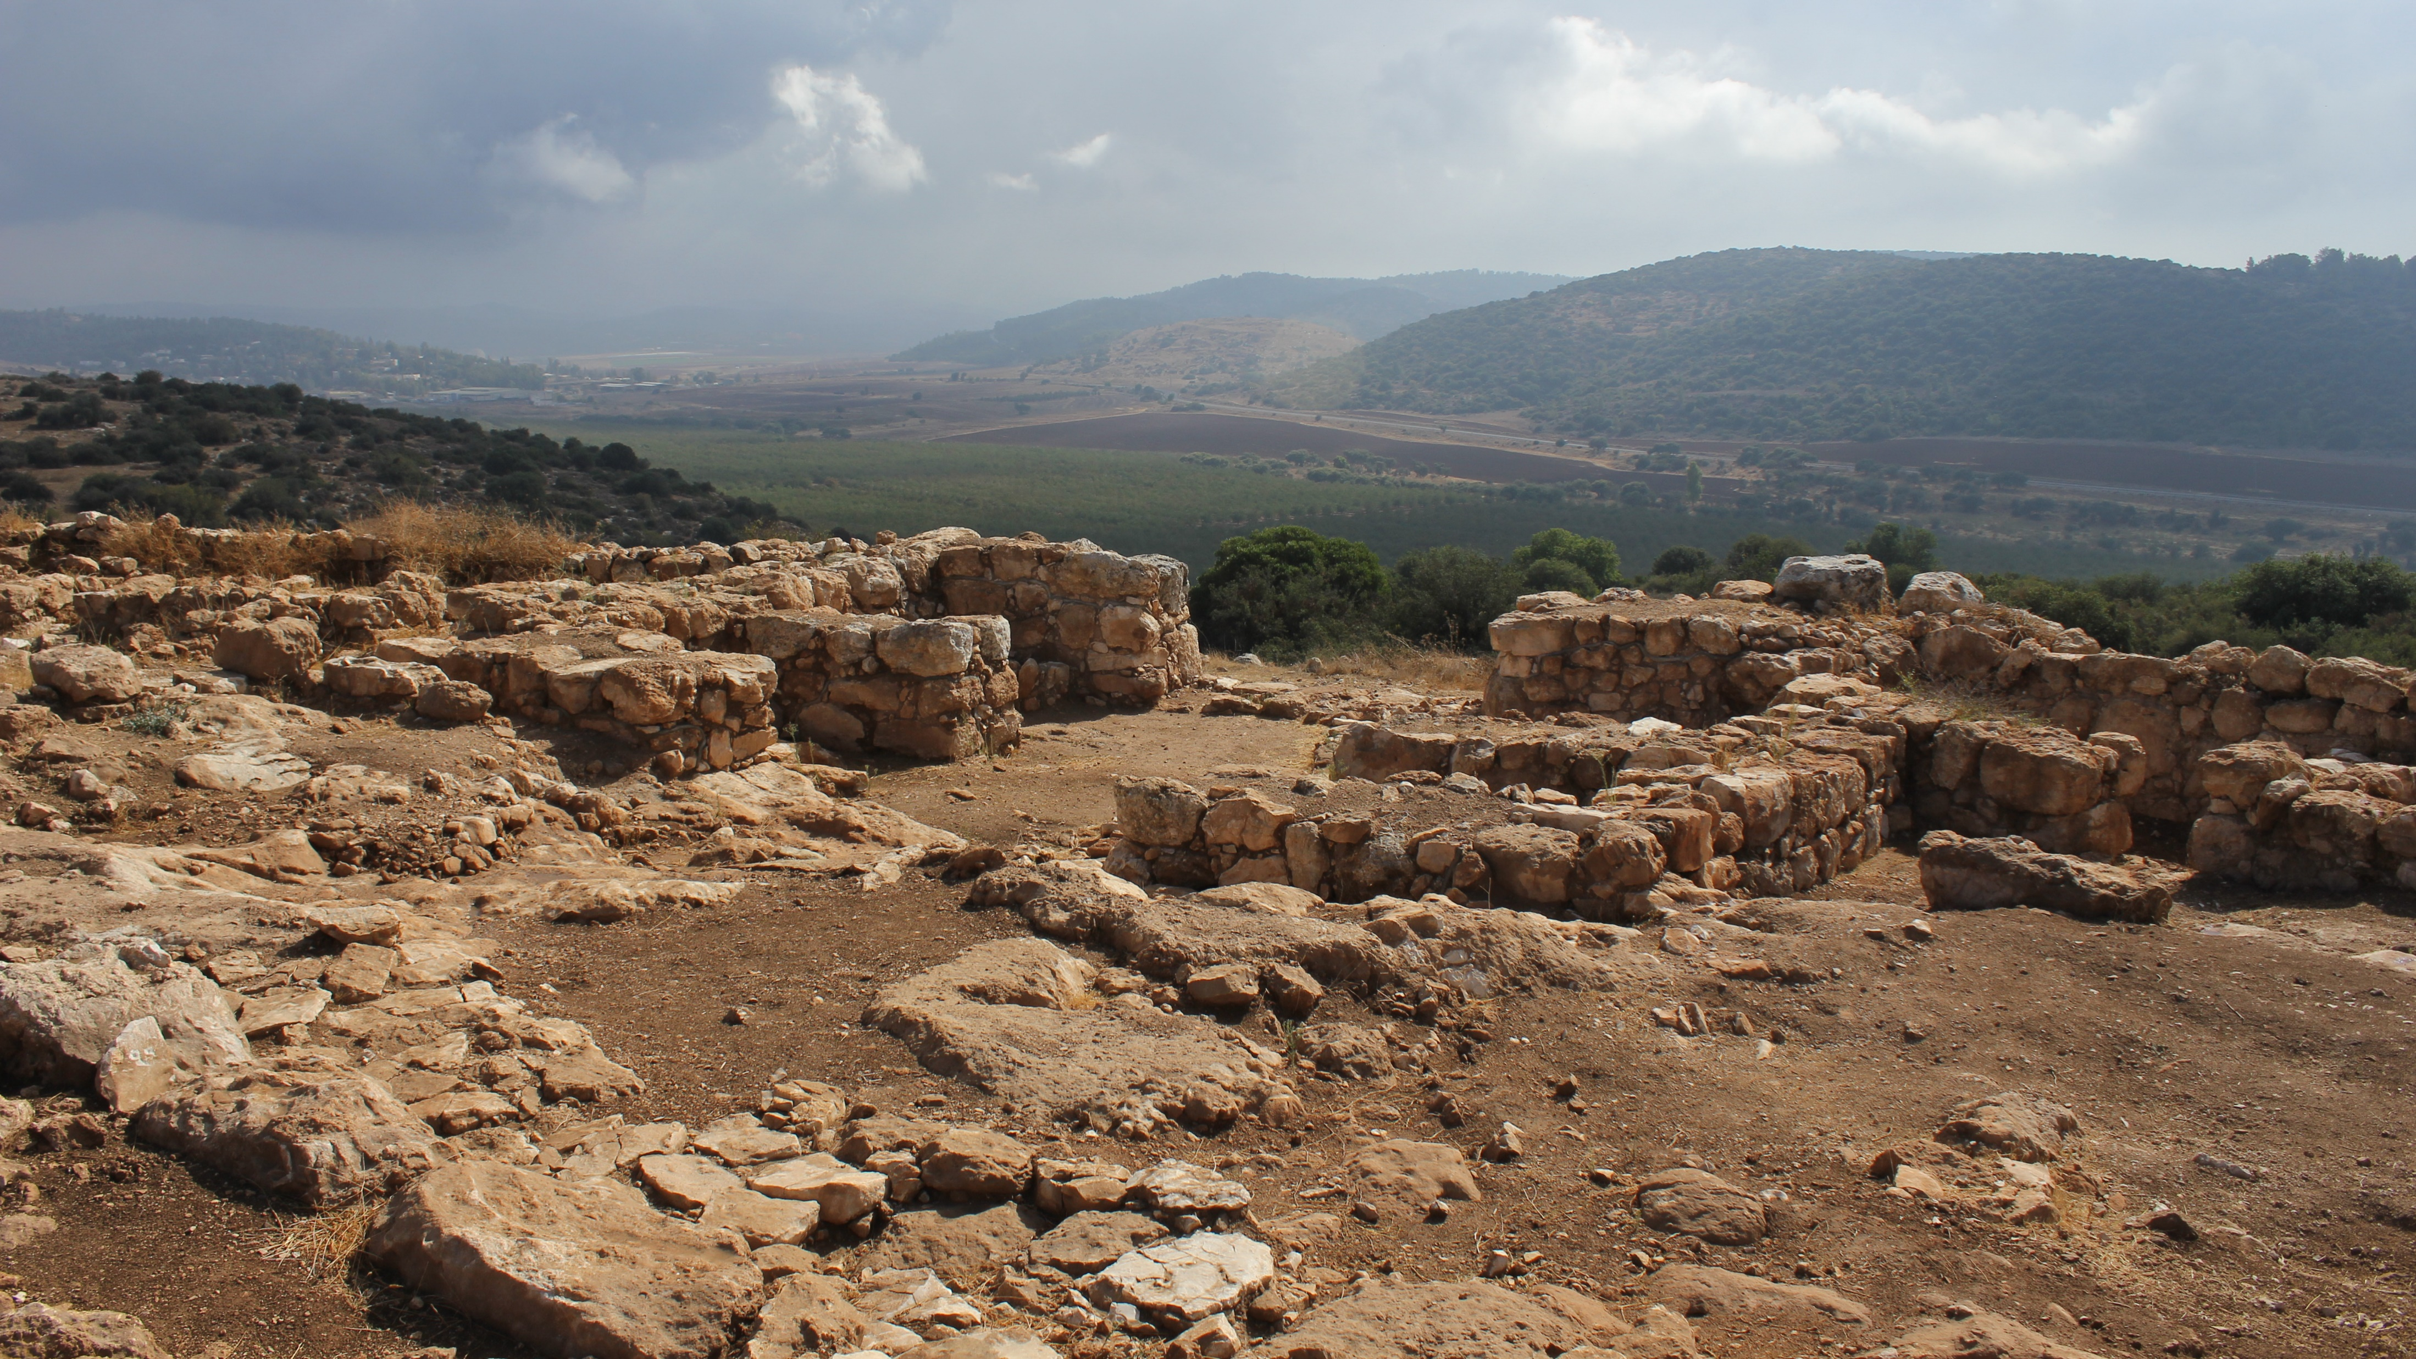
Khirbet Qeiyafa
(Daniel C Browning Jr, 2012)

Slide 10
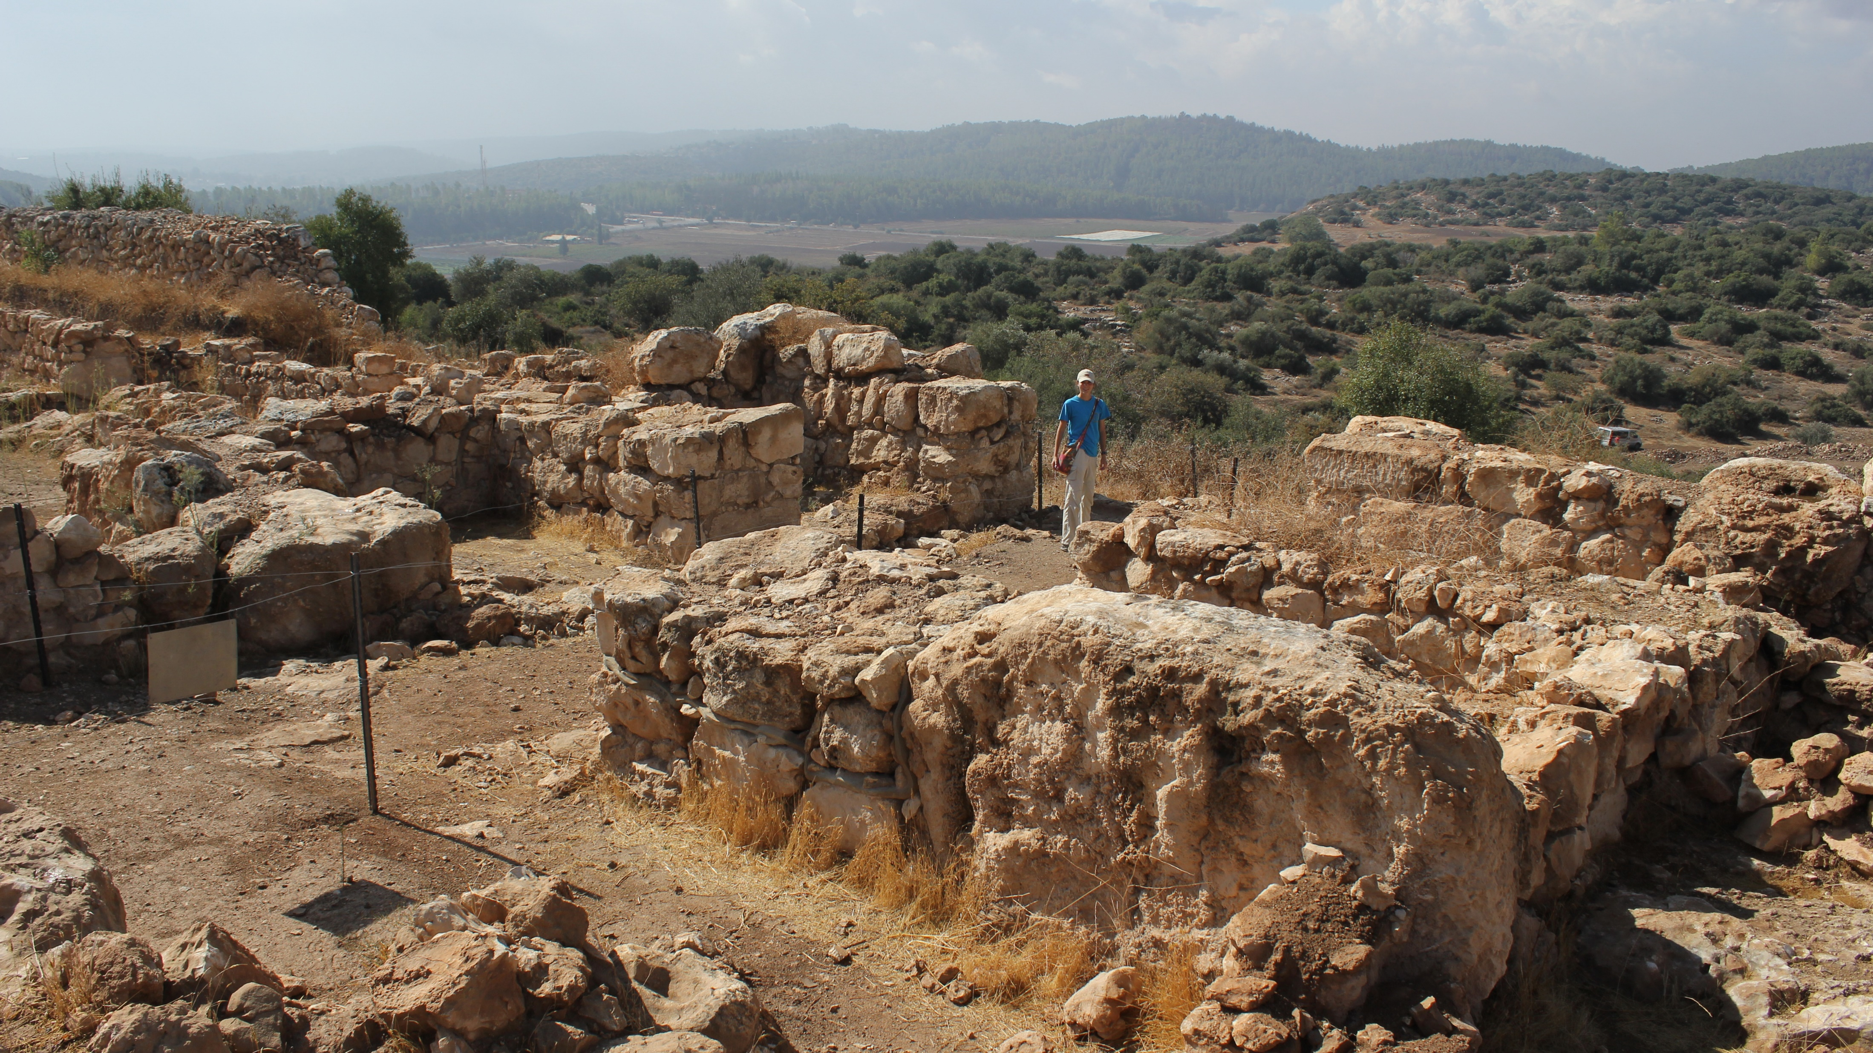
Khirbet Qeiyafa
(Daniel C Browning Jr, 2012)

Slide 11
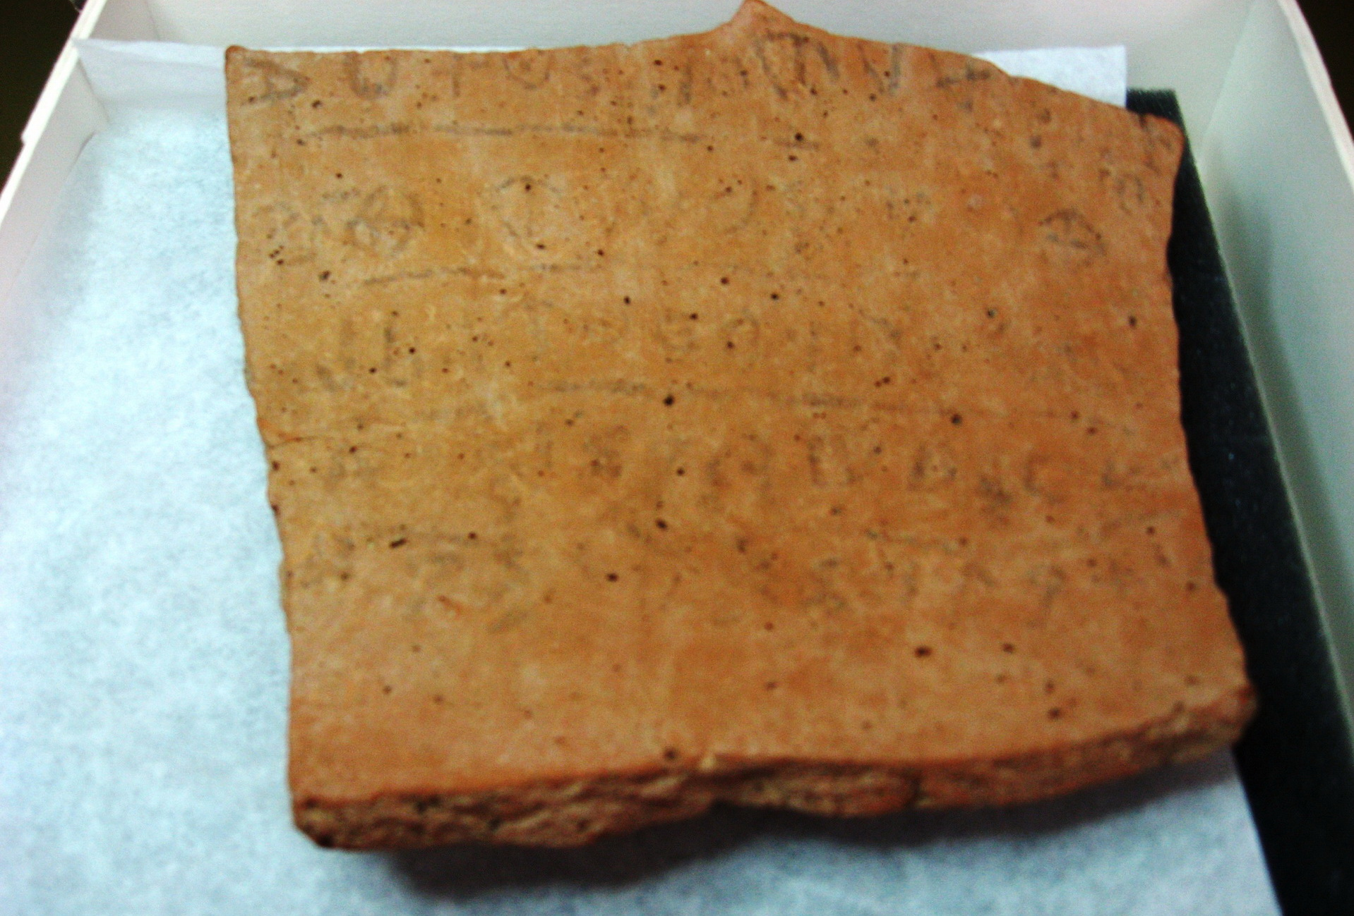
Khirbet Qeiyafa
(Daniel C Browning Jr, 2012)

Slide 12
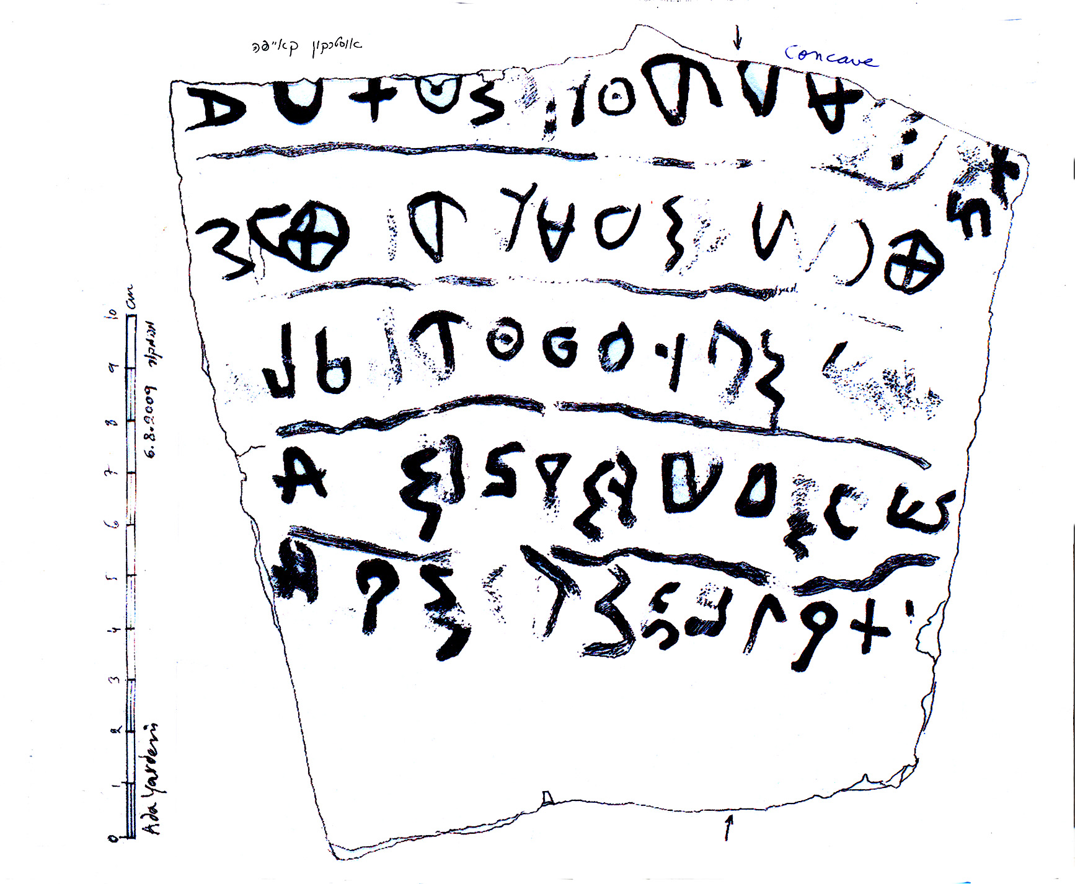
Khirbet Qeiyafa

Slide 13
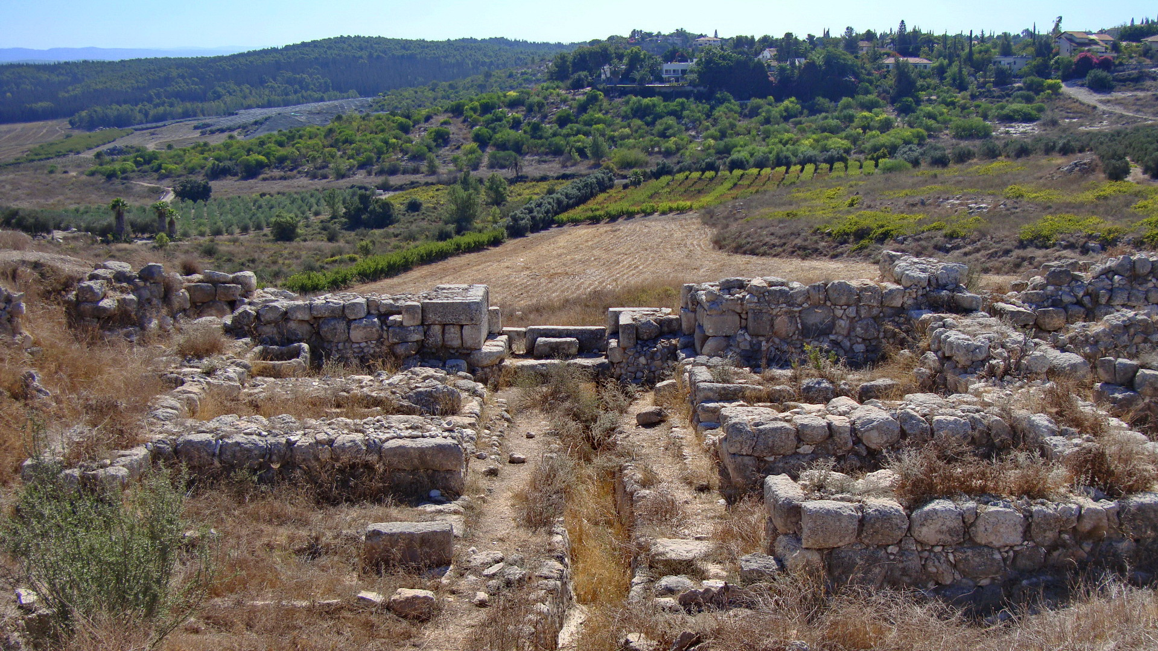
Gezer
(Daniel C Browning Jr, 2010)

Slide 14
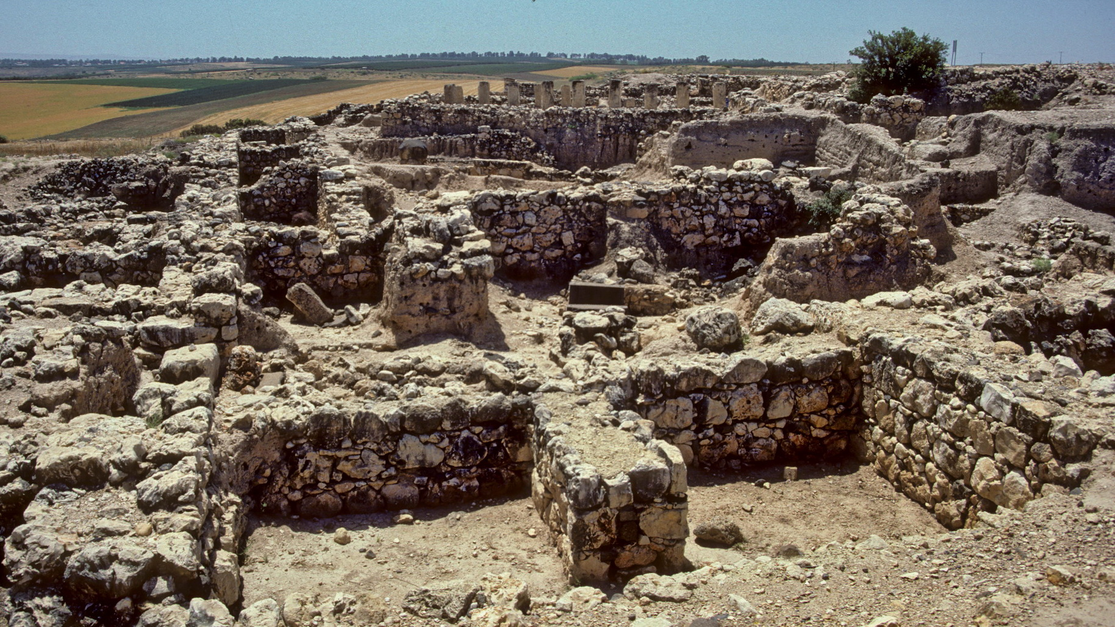
Hazor
(Daniel C Browning Jr, 2000)
Israel

Slide 15
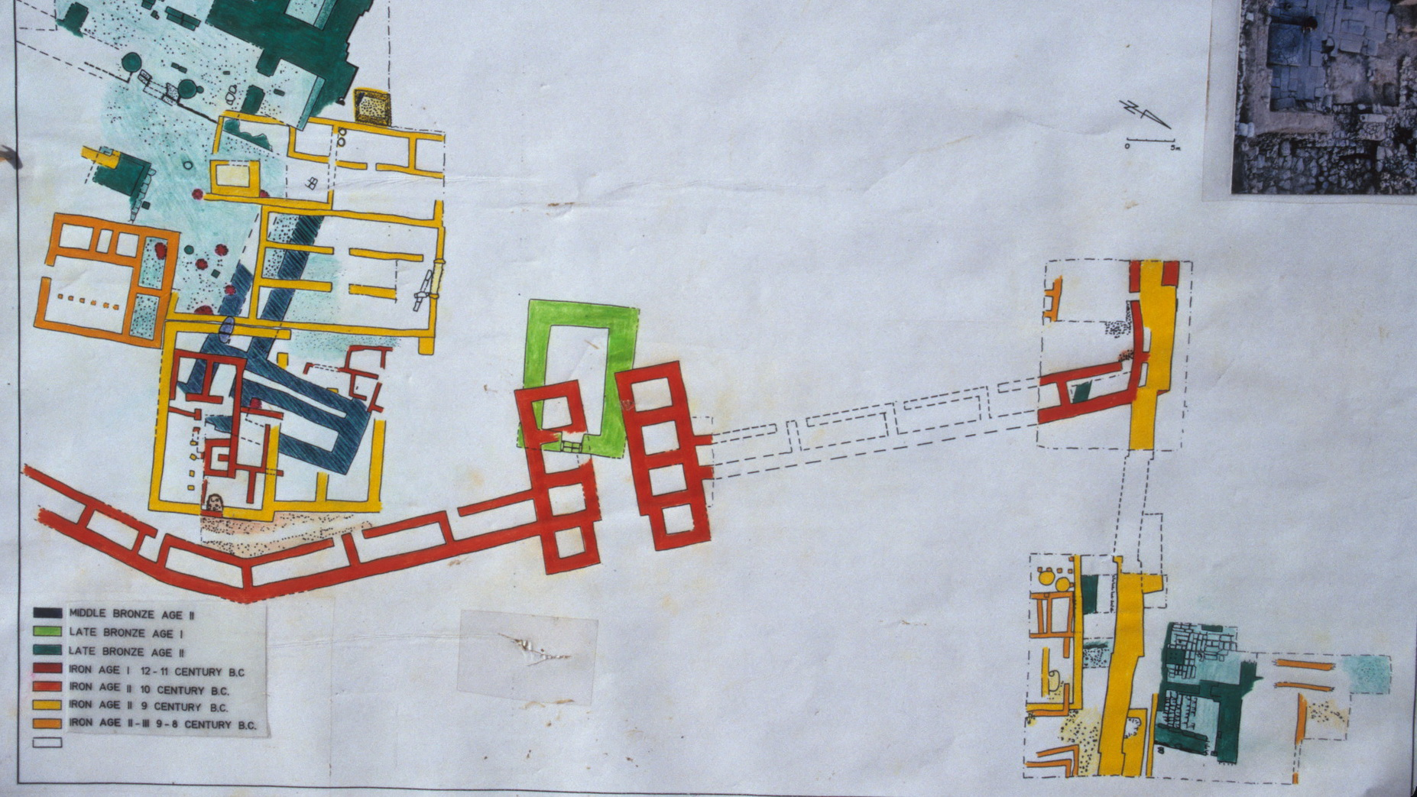
Israel
Hazor
(Daniel C Browning Jr, 2000)

Slide 16
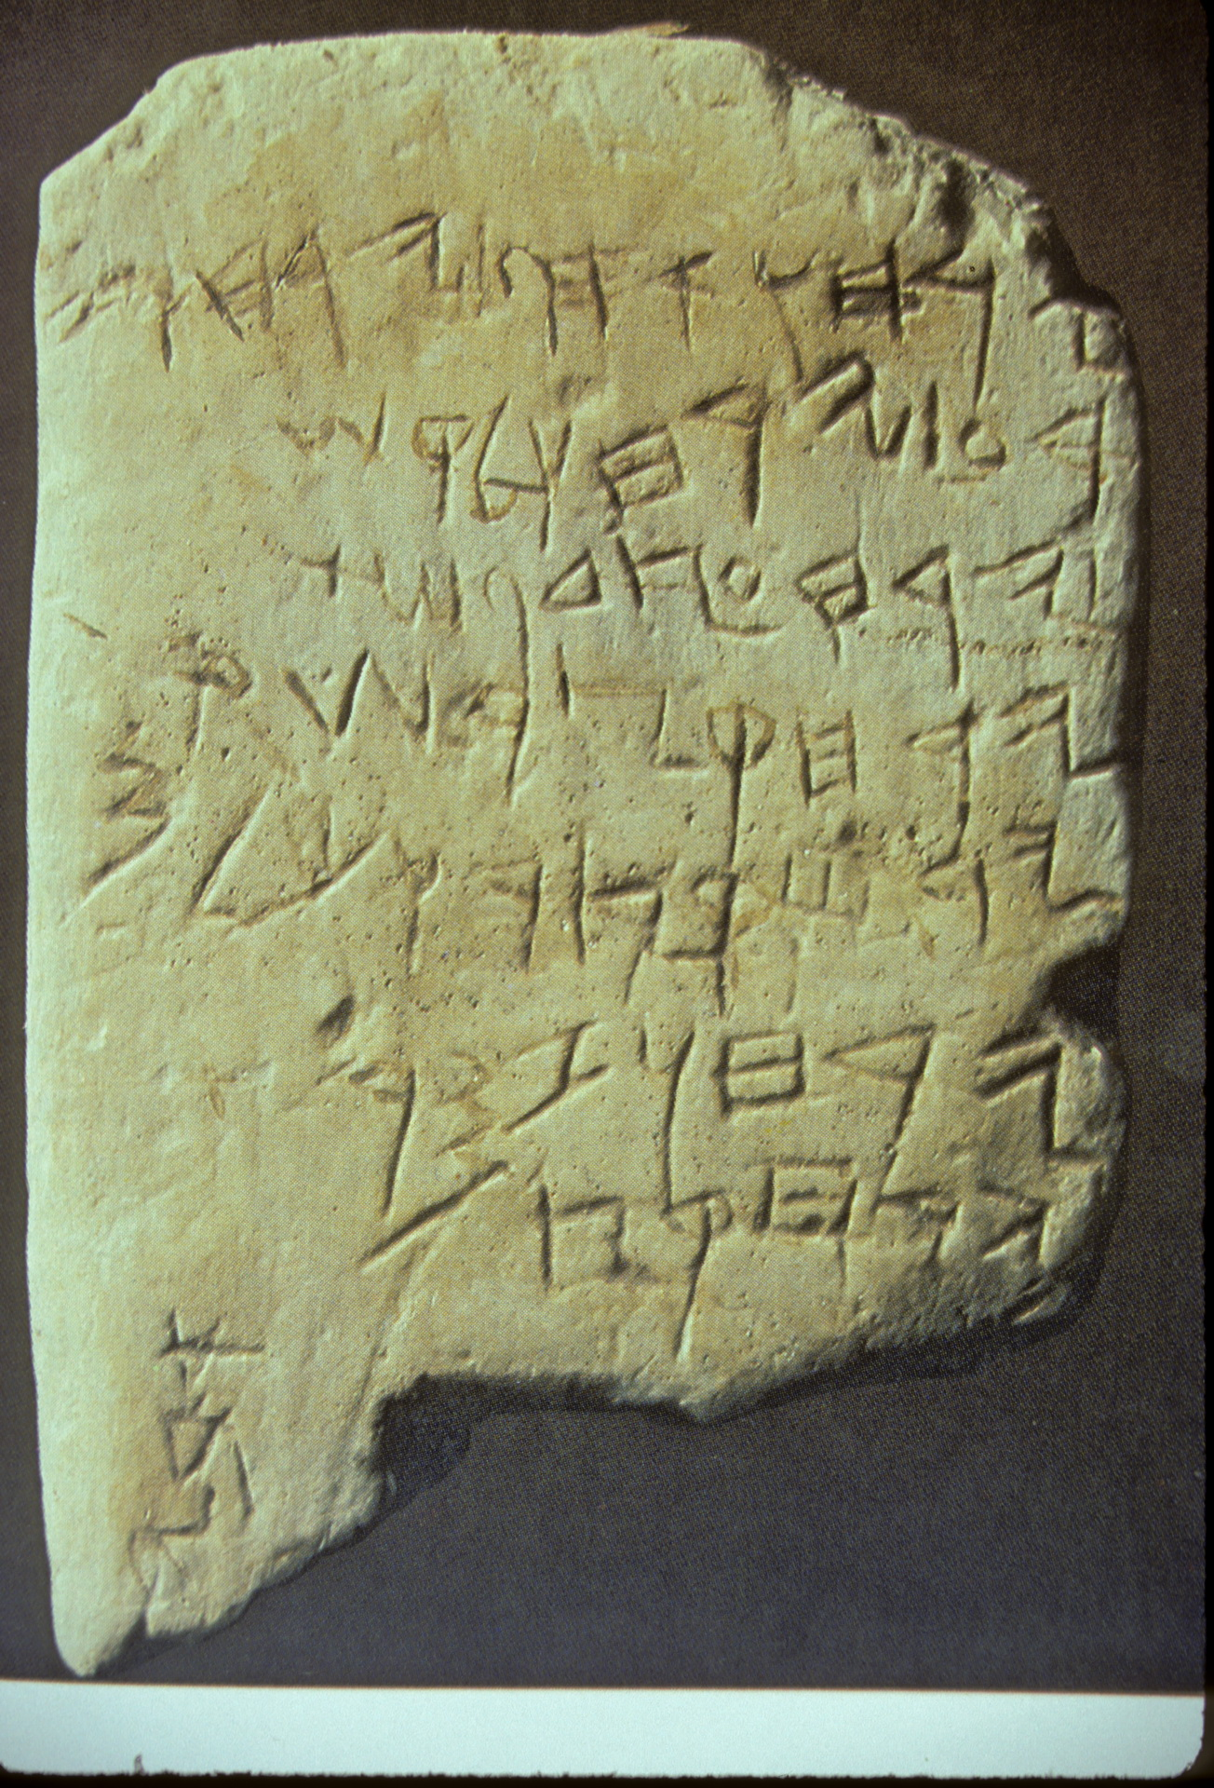
Gezer Calendar

Slide 17
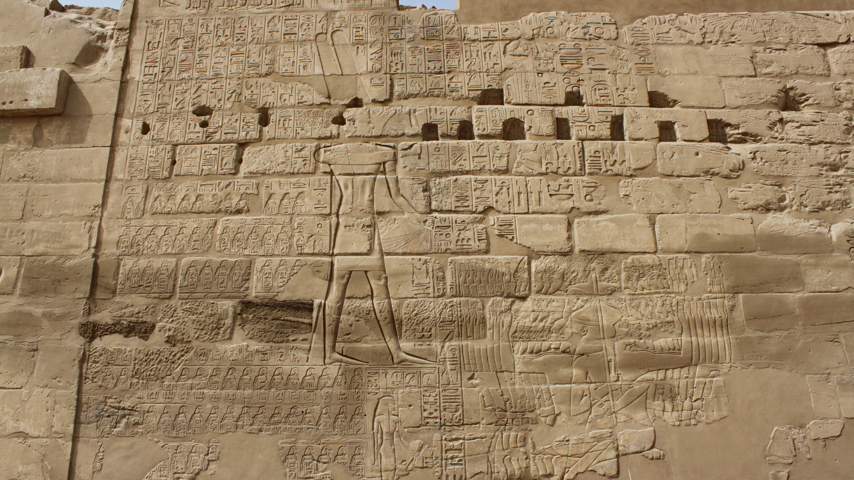
Karnak
(Daniel C Browning Jr, 2010)

Slide 18
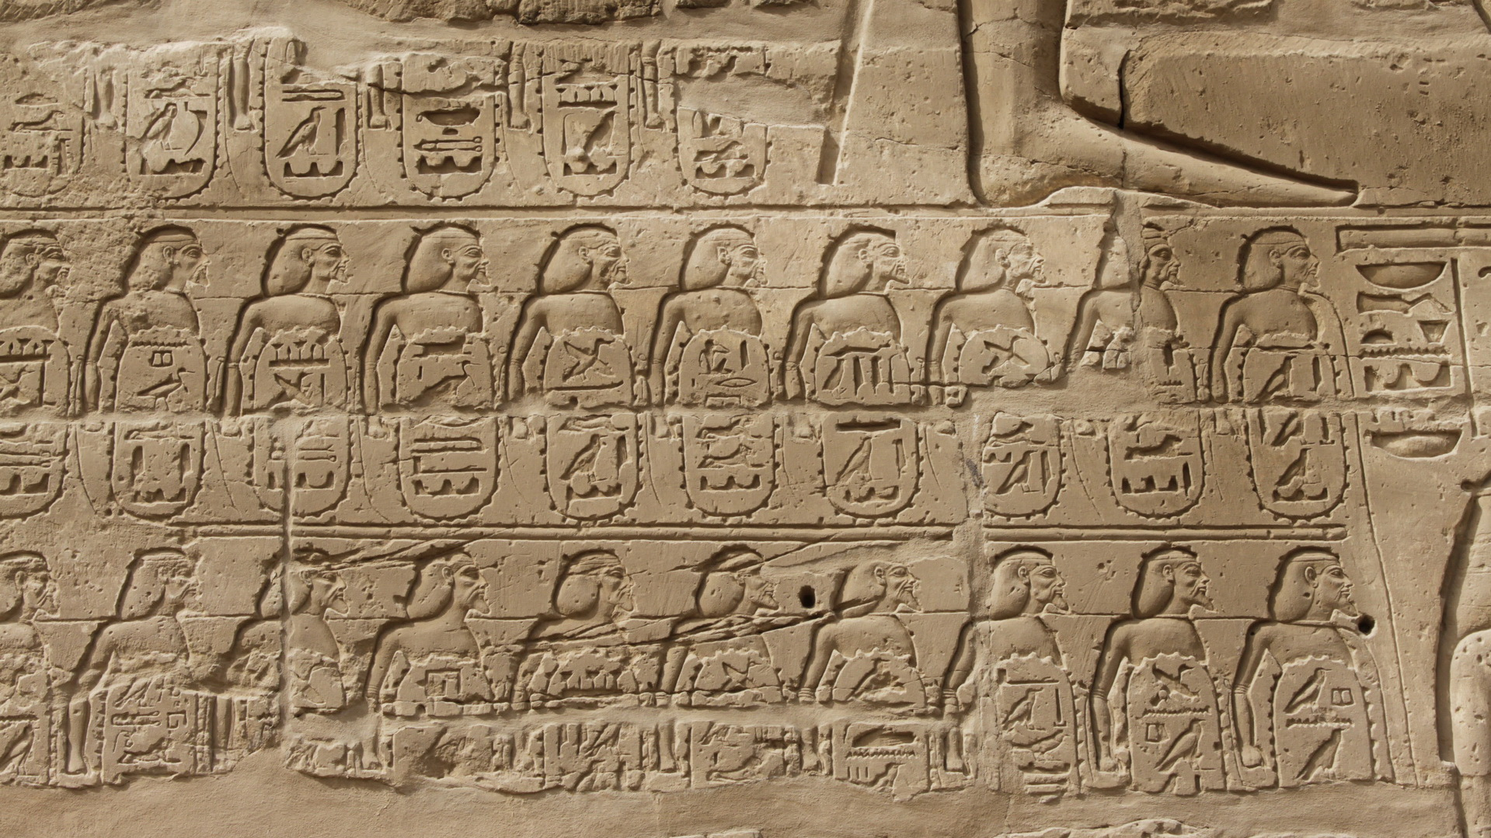
Karnak
(Daniel C Browning Jr, 2010)

Slide 19
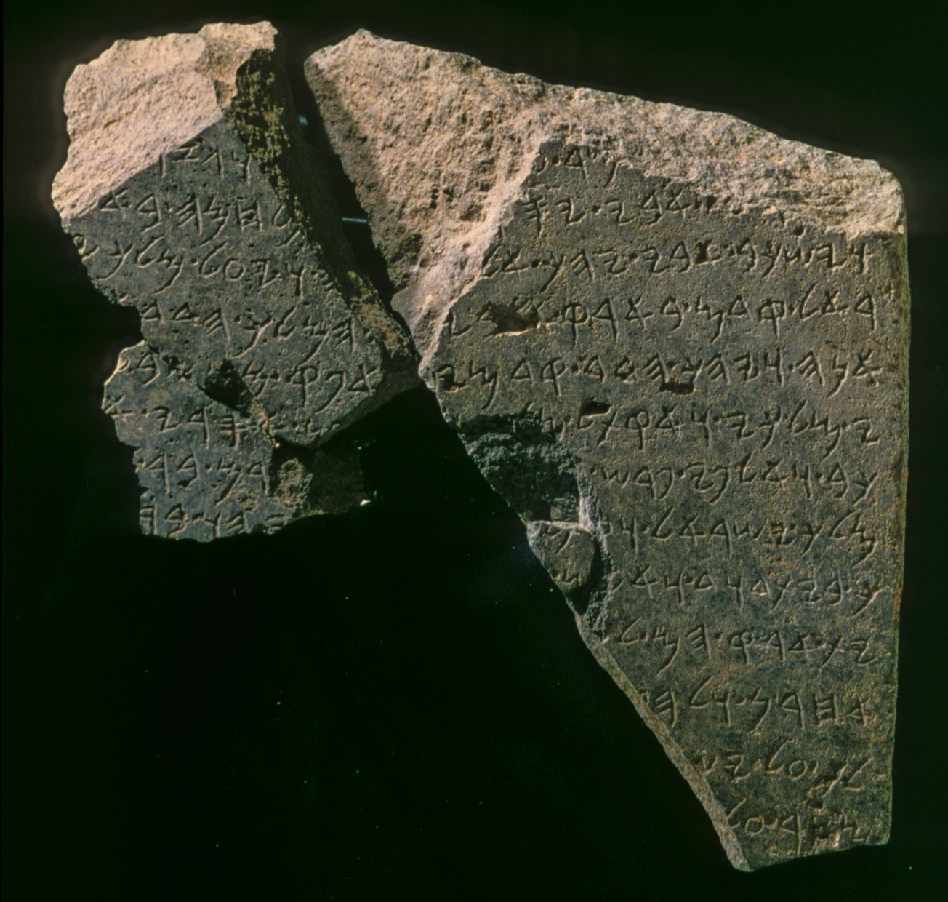
“David” inscription from Tel Dan

Slide 20
Basic Outline of Hebrew Bible History
PATRIARCHS: Abraham, Isaac, Jacob & sons (Middle Bronze Age)
SOJOURN IN EGYPT: move to Egypt under Joseph, eventual enslavement (Late Bronze Age)
EXODUS: Moses leads Israelites from Egypt, Mosaic Law at Sinai (End of Late Bronze Age)
CONQUEST: Joshua leads military invasion of Canaan, the “Promised Land” (Beginning of Iron Age)
JUDGES: Israel in tribal organization with local rule, struggle with other nations (Early Iron Age)
UNITED MONARCHY: 1st king over all Israel, Saul, superseded by David & Solomon (c. 1000-925 bc)
DIVIDED MONARCHY: after Solomon; Judah remains under Davidic dynasty, N tribes = Israel
  In the 9th century (after 900) bc, Assyria was a growing threat

Slide 21
The Iron Age in the Near East, Egypt, & E Mediterranean
(c. 1200-333 bce)
Appox Dates bce | EGYPT | SYRIA-PALESTINE | GREECE | ANATOLIA | MESOPOTAMIA
1200-900 | Weak continuation of New Kingdom 3rd Intermediate Period Shoshenq (Shishak) I c. 925 bce | Rise of New Nations Phoenicians Philistines Arameans Moab & Edom Israel | Dark Age Migration of Greek groups | Greek Colonists in Aegean Coast Neo-Hittite States in SE | Middle Assyrian Period Neo-Hittite States in NW Rise of Aramean City-States N and NW Babylon continues in S
900-550
550-333

Slide 22
The Iron Age in the Near East, Egypt, & E Mediterranean
(c. 1200-333 bce)
Appox Dates bce | EGYPT | SYRIA-PALESTINE | GREECE | ANATOLIA | MESOPOTAMIA
1200-900 | Weak continuation of New Kingdom 3rd Intermediate Period Shoshenq (Shishak) I c. 925 bce | Rise of New Nations Phoenicians Philistines Arameans Moab & Edom Israel | Dark Age Migration of Greek groups | Greek Colonists in Aegean Coast Neo-Hittite States in SE | Middle Assyrian Period Neo-Hittite States in NW Rise of Aramean City-States N and NW Babylon continues in S
900-550 | Struggle with Assyria/ Babylon | Israel and Judah Domination by Assyria/Babylon | Archaic Period More Colonies | Domination by Assyria/Babylon | (Neo-)Assyrian Empire (Neo-)Babylonian Empire
550-333

Slide 23
The Later Iron Age in the Near East, Egypt
Assyrian and Babylonian Empires (c. 900-500 bce)
Interregional contact and trade slowly reestablished
Assyria & (later) Babylon dominated Mesopotamia and attempted to project empires beyond Mesopotamia
Ultimate goal of Mesopotamian empires was always Egypt
Smaller national states became vassals in this struggle
Contemporary text sources reappear; often in the form of propagandistic monuments
Literary sources, most written later, also provide data
The nations Israel and Judah, documented in the Hebrew Bible (Old Testament) provide a great example picture . . .

Slide 24
The Later Iron Age in the Near East, Egypt
Assyrian and Babylonian Empires (c. 900-500 bce)
Interregional contact and trade slowly reestablished
Assyria & (later) Babylon dominated Mesopotamia and attempted to project empires beyond Mesopotamia
Ultimate goal of Mesopotamian empires was always Egypt
Smaller national states became vassals in this struggle
Contemporary text sources reappear; often in the form of propagandistic monuments
Literary sources, most written later, also provide data
The nations Israel and Judah, documented in the Hebrew Bible (Old Testament) provide a great example picture . . .

Slide 25
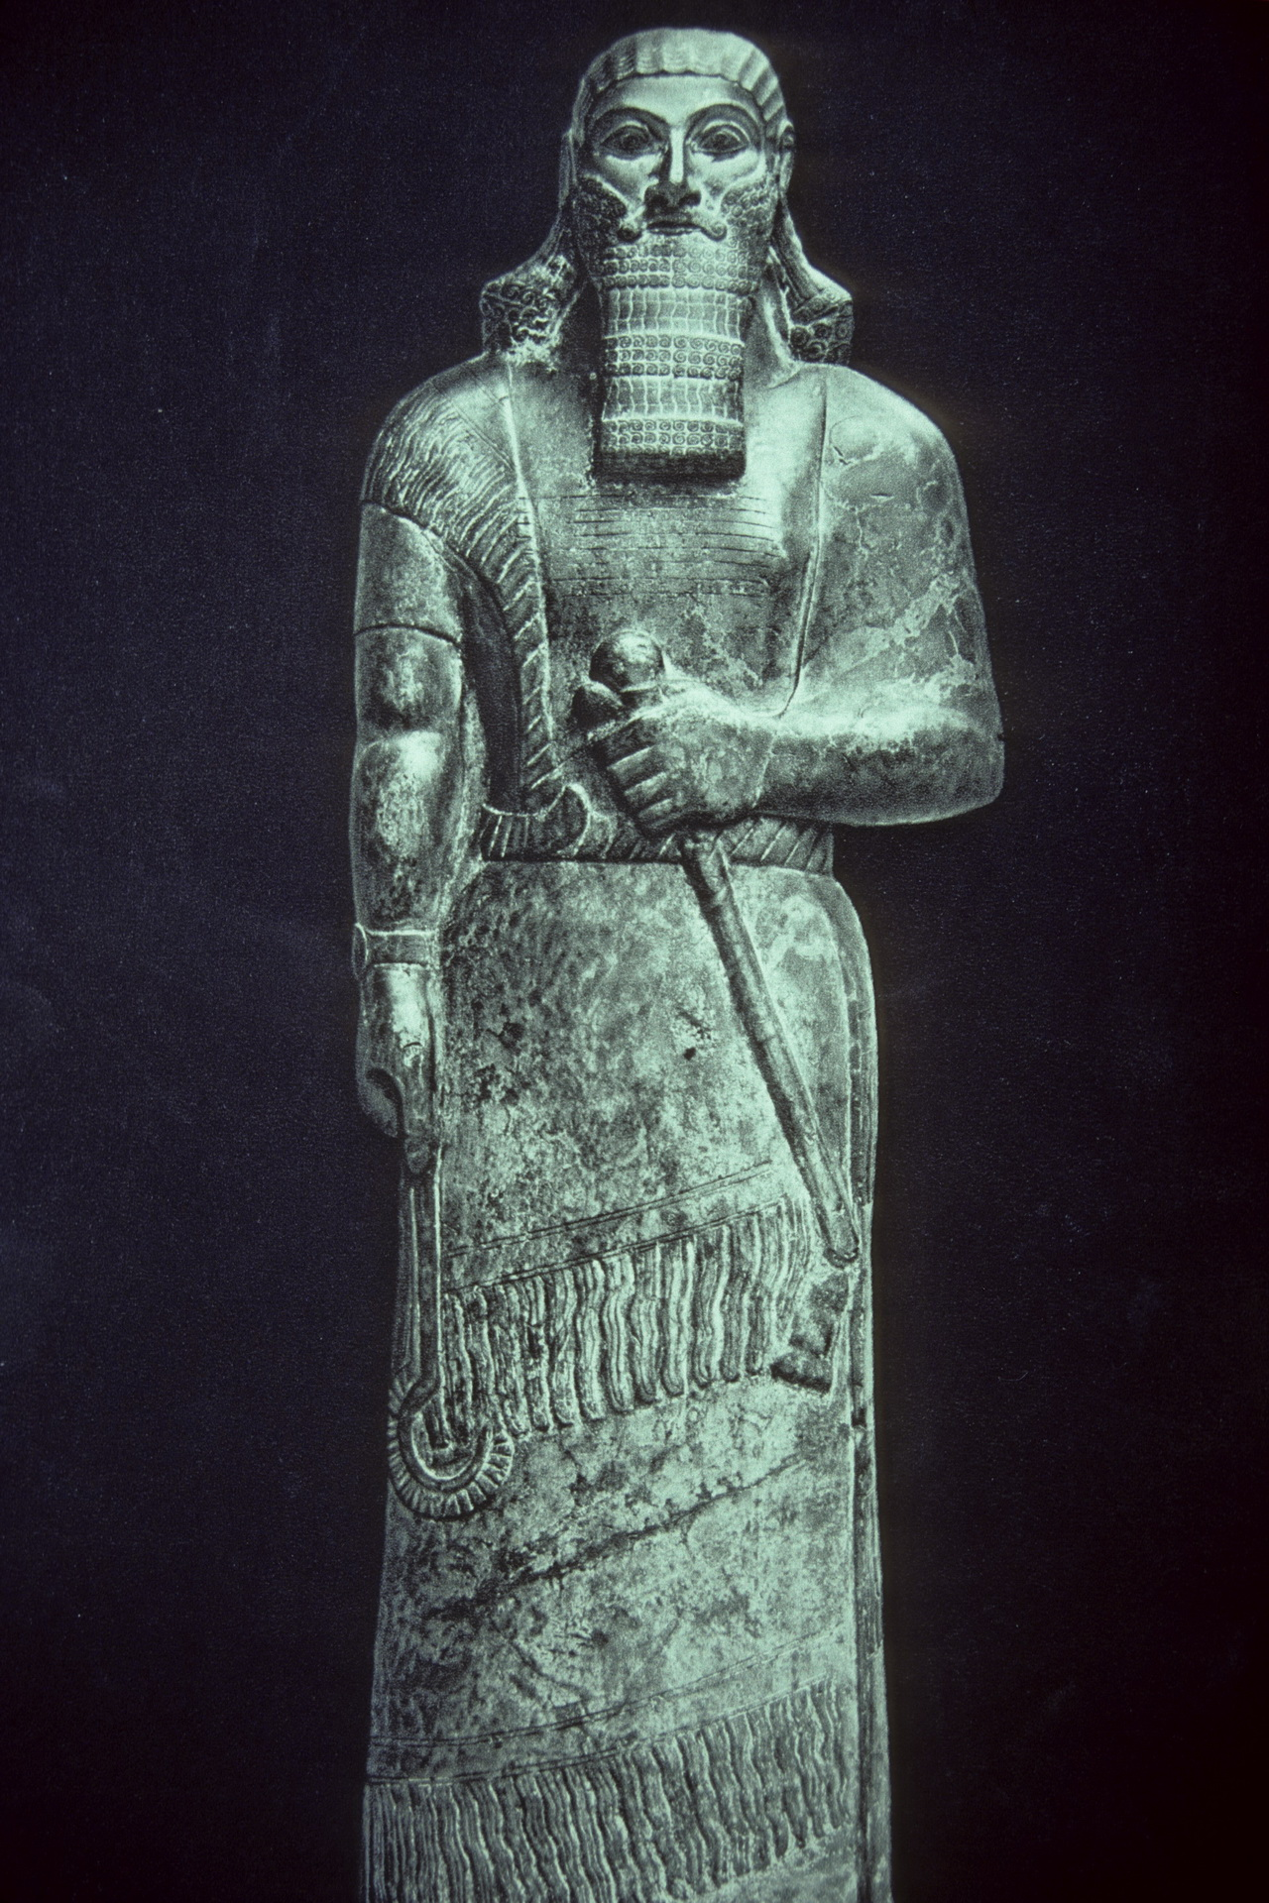
Assurnasirpal

Slide 26
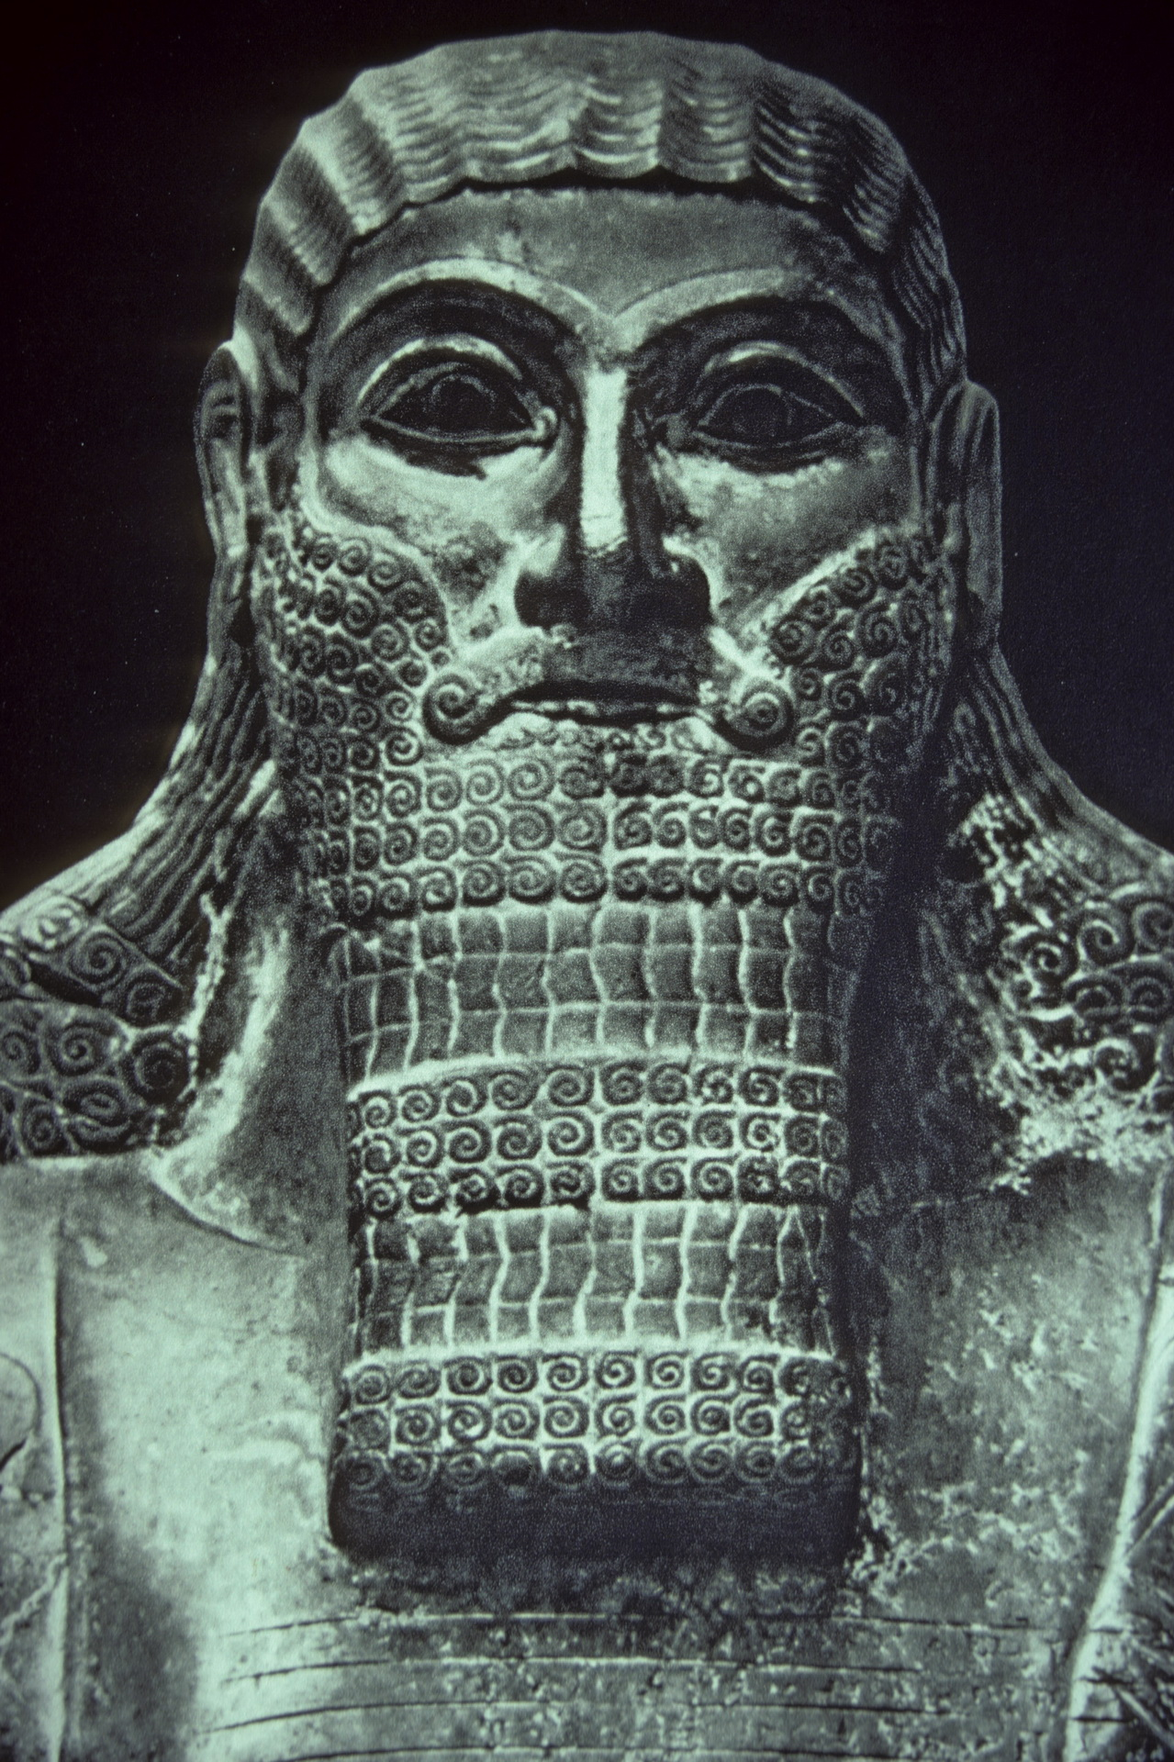
Assurnasirpal

Slide 27
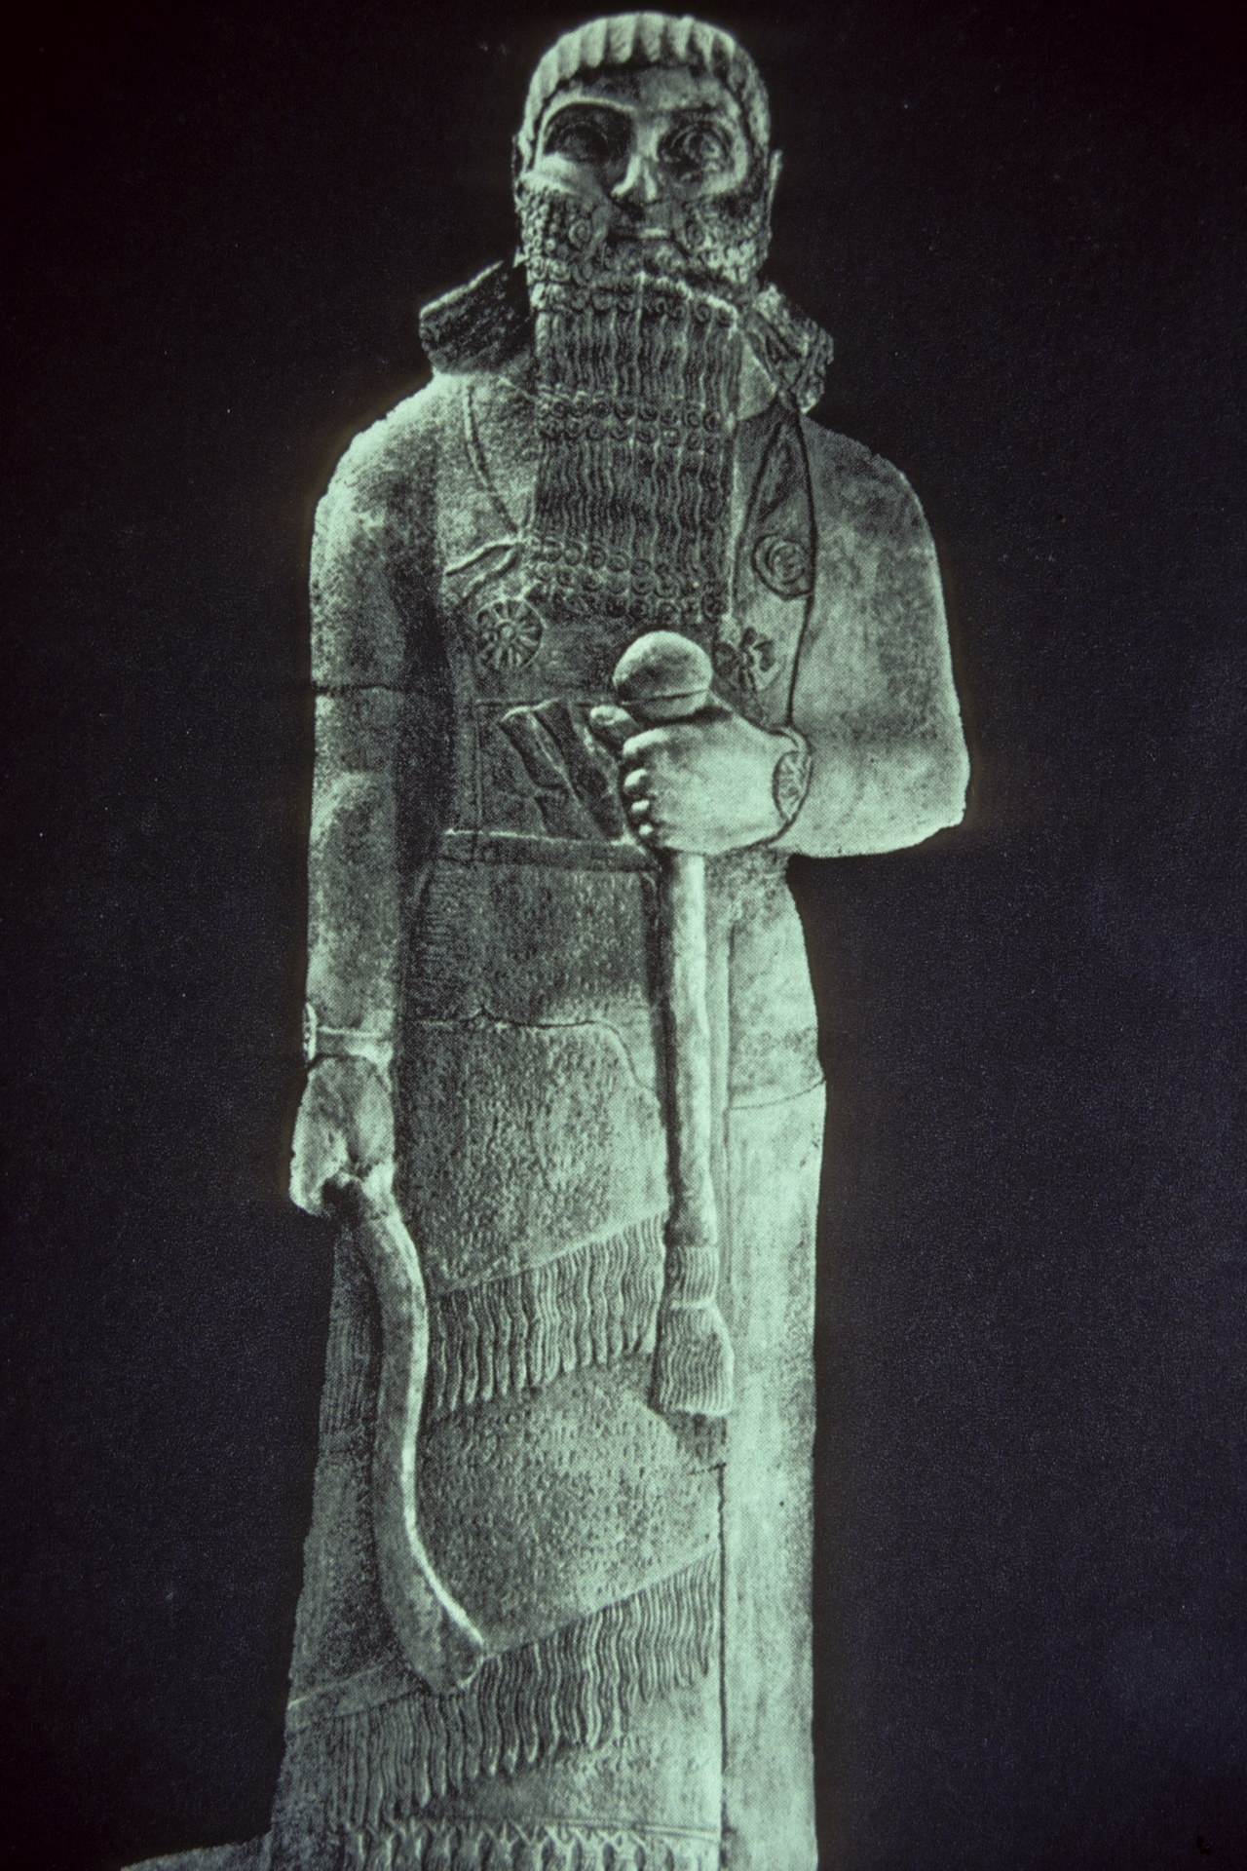
Shalmaneser III

Slide 28
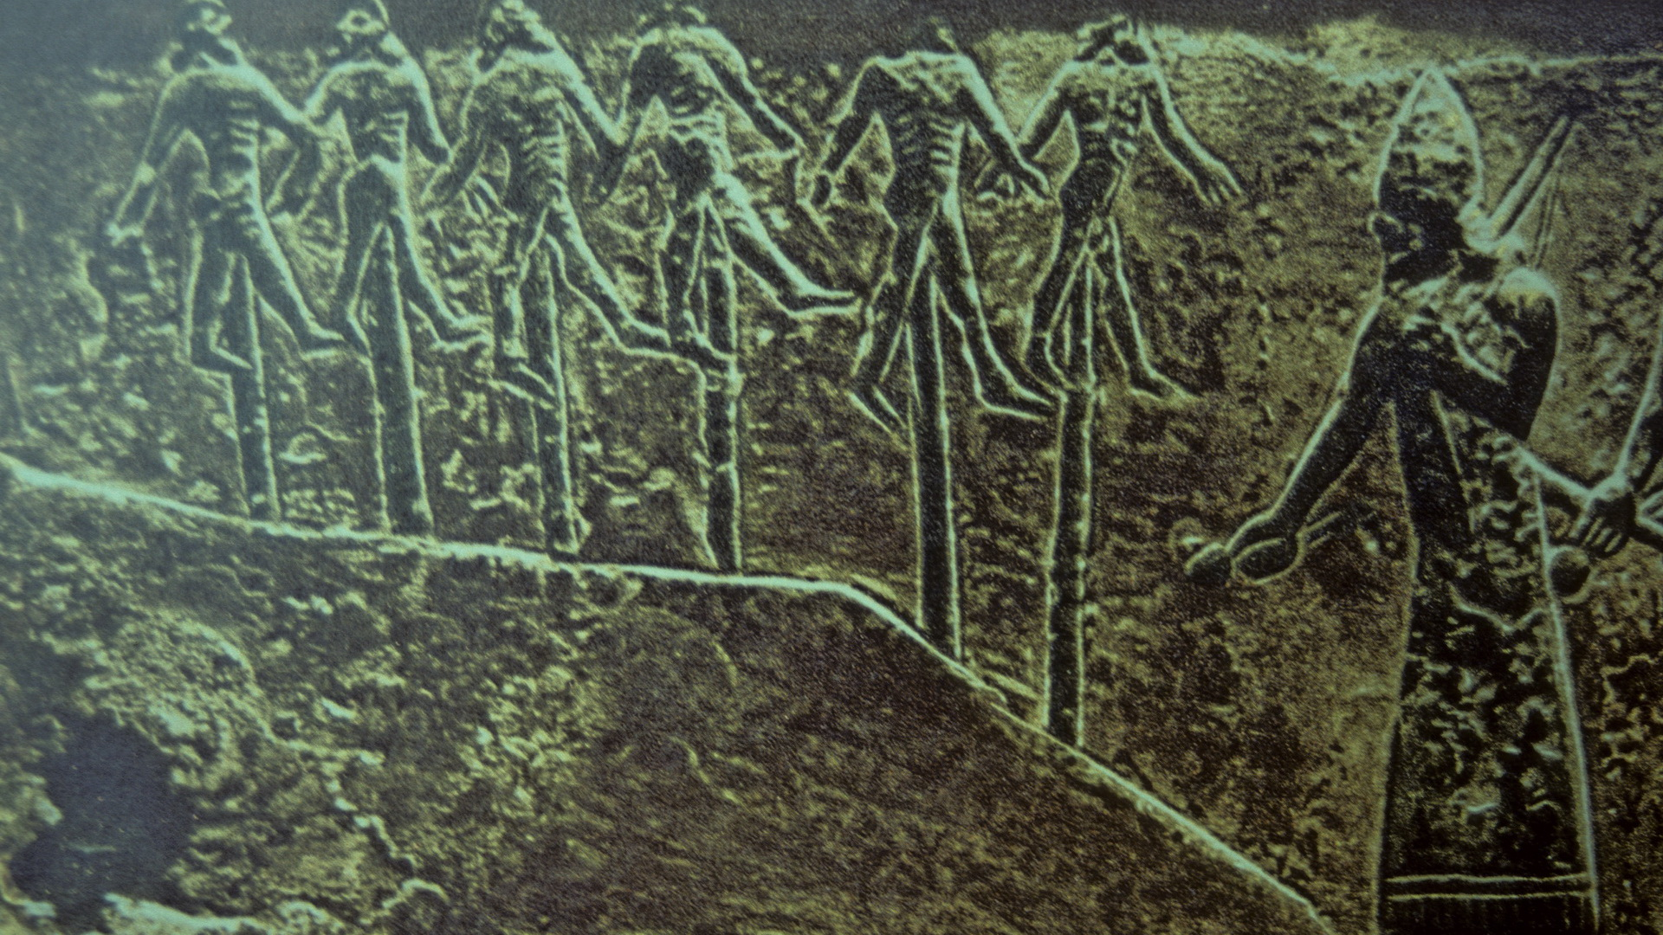

Slide 30
Basic Outline of Hebrew Bible History
PATRIARCHS: Abraham, Isaac, Jacob & sons (Middle Bronze Age)
SOJOURN IN EGYPT: move to Egypt under Joseph, eventual enslavement (Late Bronze Age)
EXODUS: Moses leads Israelites from Egypt, Mosaic Law at Sinai (End of Late Bronze Age)
CONQUEST: Joshua leads military invasion of Canaan, the “Promised Land” (Beginning of Iron Age)
JUDGES: Israel in tribal organization with local rule, struggle with other nations (Early Iron Age)
UNITED MONARCHY: 1st king over all Israel, Saul, superseded by David & Solomon (c. 1000-925 bc)
DIVIDED MONARCHY: after Solomon; Judah remains under Davidic dynasty, N tribes = Israel
  In the 9th century (after 900) bc, Assyria was a growing threat
    Israel and neighbors united as a coalition to face Assyrian king Shalmaneser III in 853 bc
    Coalition was temporarily successful, but Shalmaneser III returned in 841

Slide 31
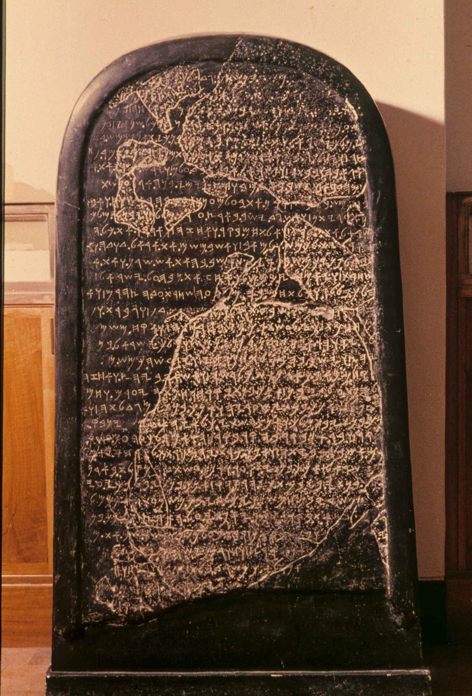
Moabite Stone/
Mesha Stele
Monument of Moabite King Mesha, tells of a rebellion from vassalage to Ahab, King of Israel (also noted in biblical account)

Slide 32
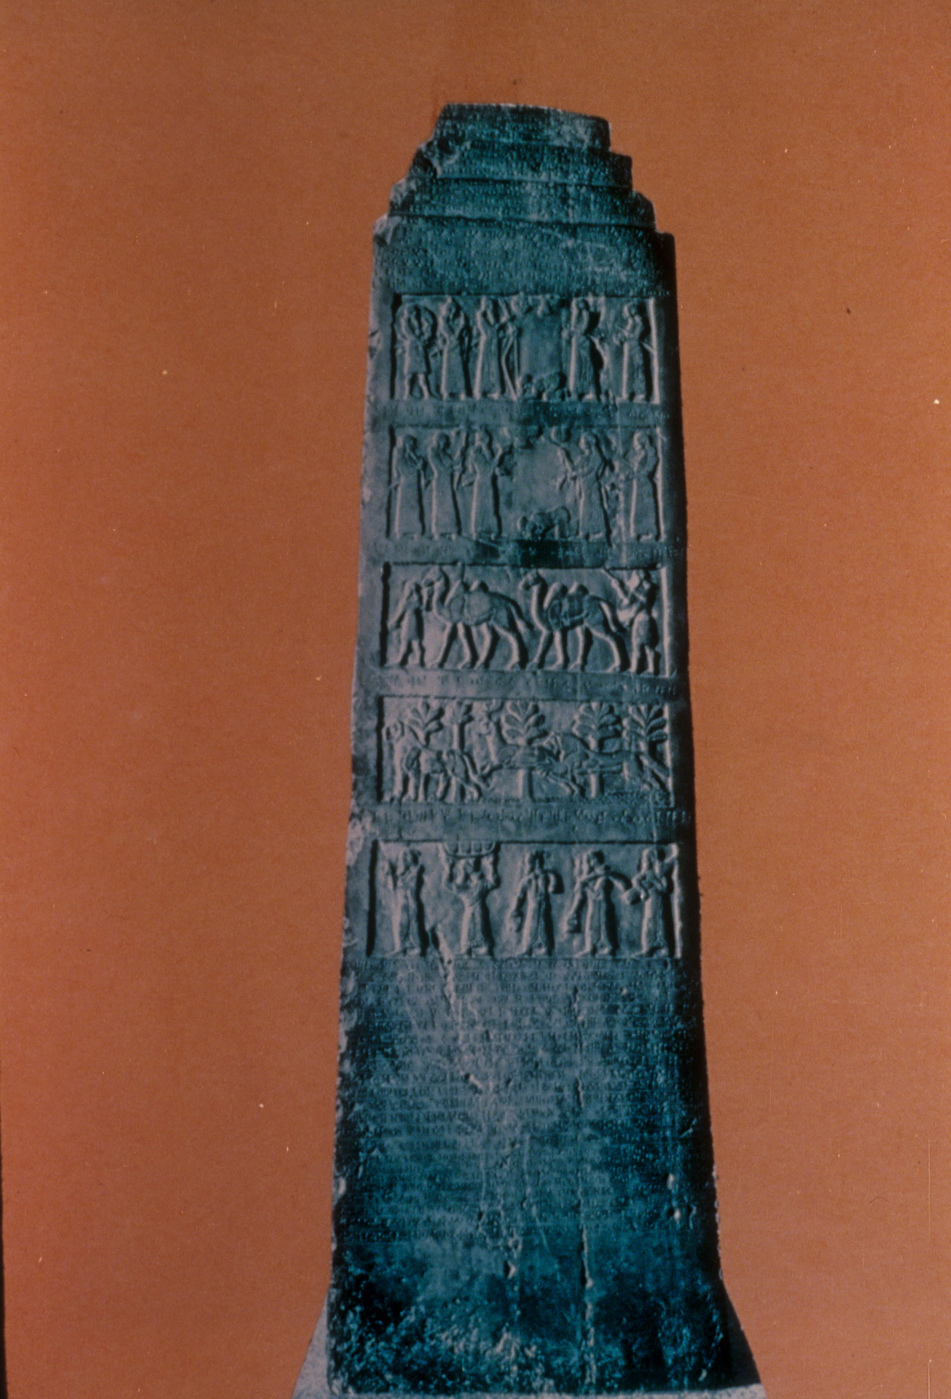
Black Obelisk of
Shalmaneser III

Slide 33
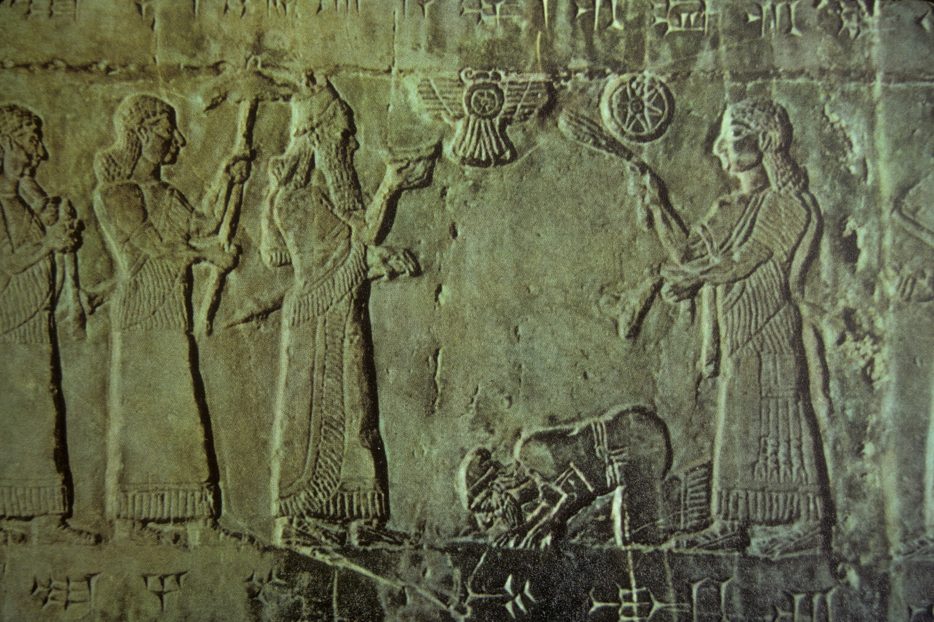
Black Obelisk of
Shalmaneser III

Slide 34
Basic Outline of Hebrew Bible History
PATRIARCHS: Abraham, Isaac, Jacob & sons (Middle Bronze Age)
SOJOURN IN EGYPT: move to Egypt under Joseph, eventual enslavement (Late Bronze Age)
EXODUS: Moses leads Israelites from Egypt, Mosaic Law at Sinai (End of Late Bronze Age)
CONQUEST: Joshua leads military invasion of Canaan, the “Promised Land” (Beginning of Iron Age)
JUDGES: Israel in tribal organization with local rule, struggle with other nations (Early Iron Age)
UNITED MONARCHY: 1st king over all Israel, Saul, superseded by David & Solomon (c. 1000-925 bc)
DIVIDED MONARCHY: after Solomon; Judah remains under Davidic dynasty, N tribes = Israel
  In the 9th century (after 900) bc, Assyria was a growing threat
    Israel and neighbors united as a coalition to face Assyrian king Shalmaneser III in 853 bc
    Coalition was temporarily successful, but Shalmaneser III returned in 841
  After a lull in early 8th century bc, Assyria revitalized under Tiglath-Pileser III in 745
    New strength, new policies on conquest
    Became the major issue for Israel, Judah, & prophets (Amos, Hosea, Isaiah, Micah)
    N nation of Israel destroyed in 722 by Assyria; Judah devastated but survived

Slide 35
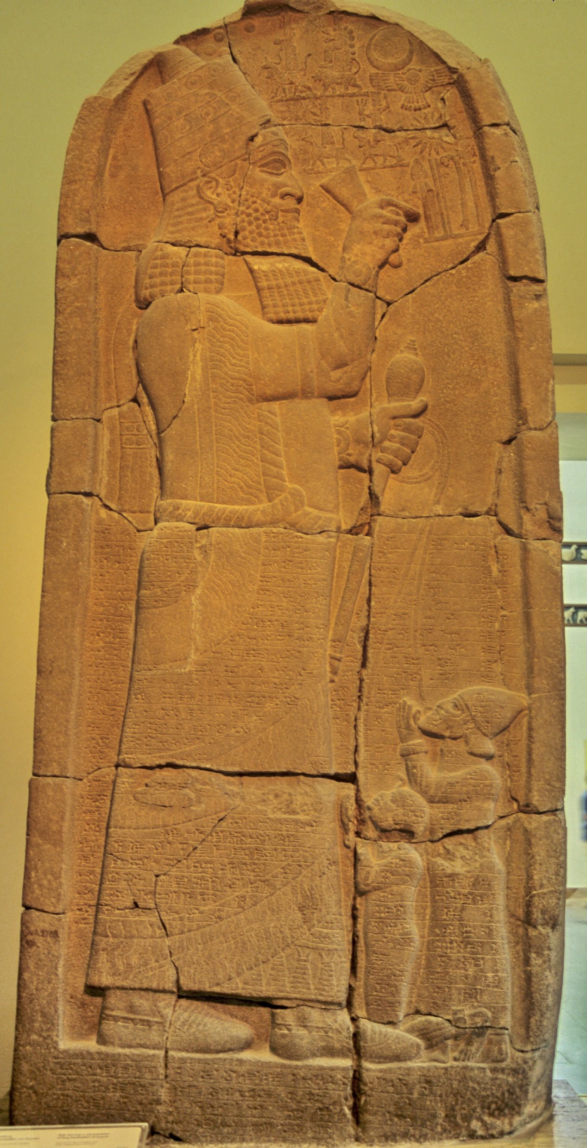
Esarhaddon, king of Assyria with captives

Slide 36
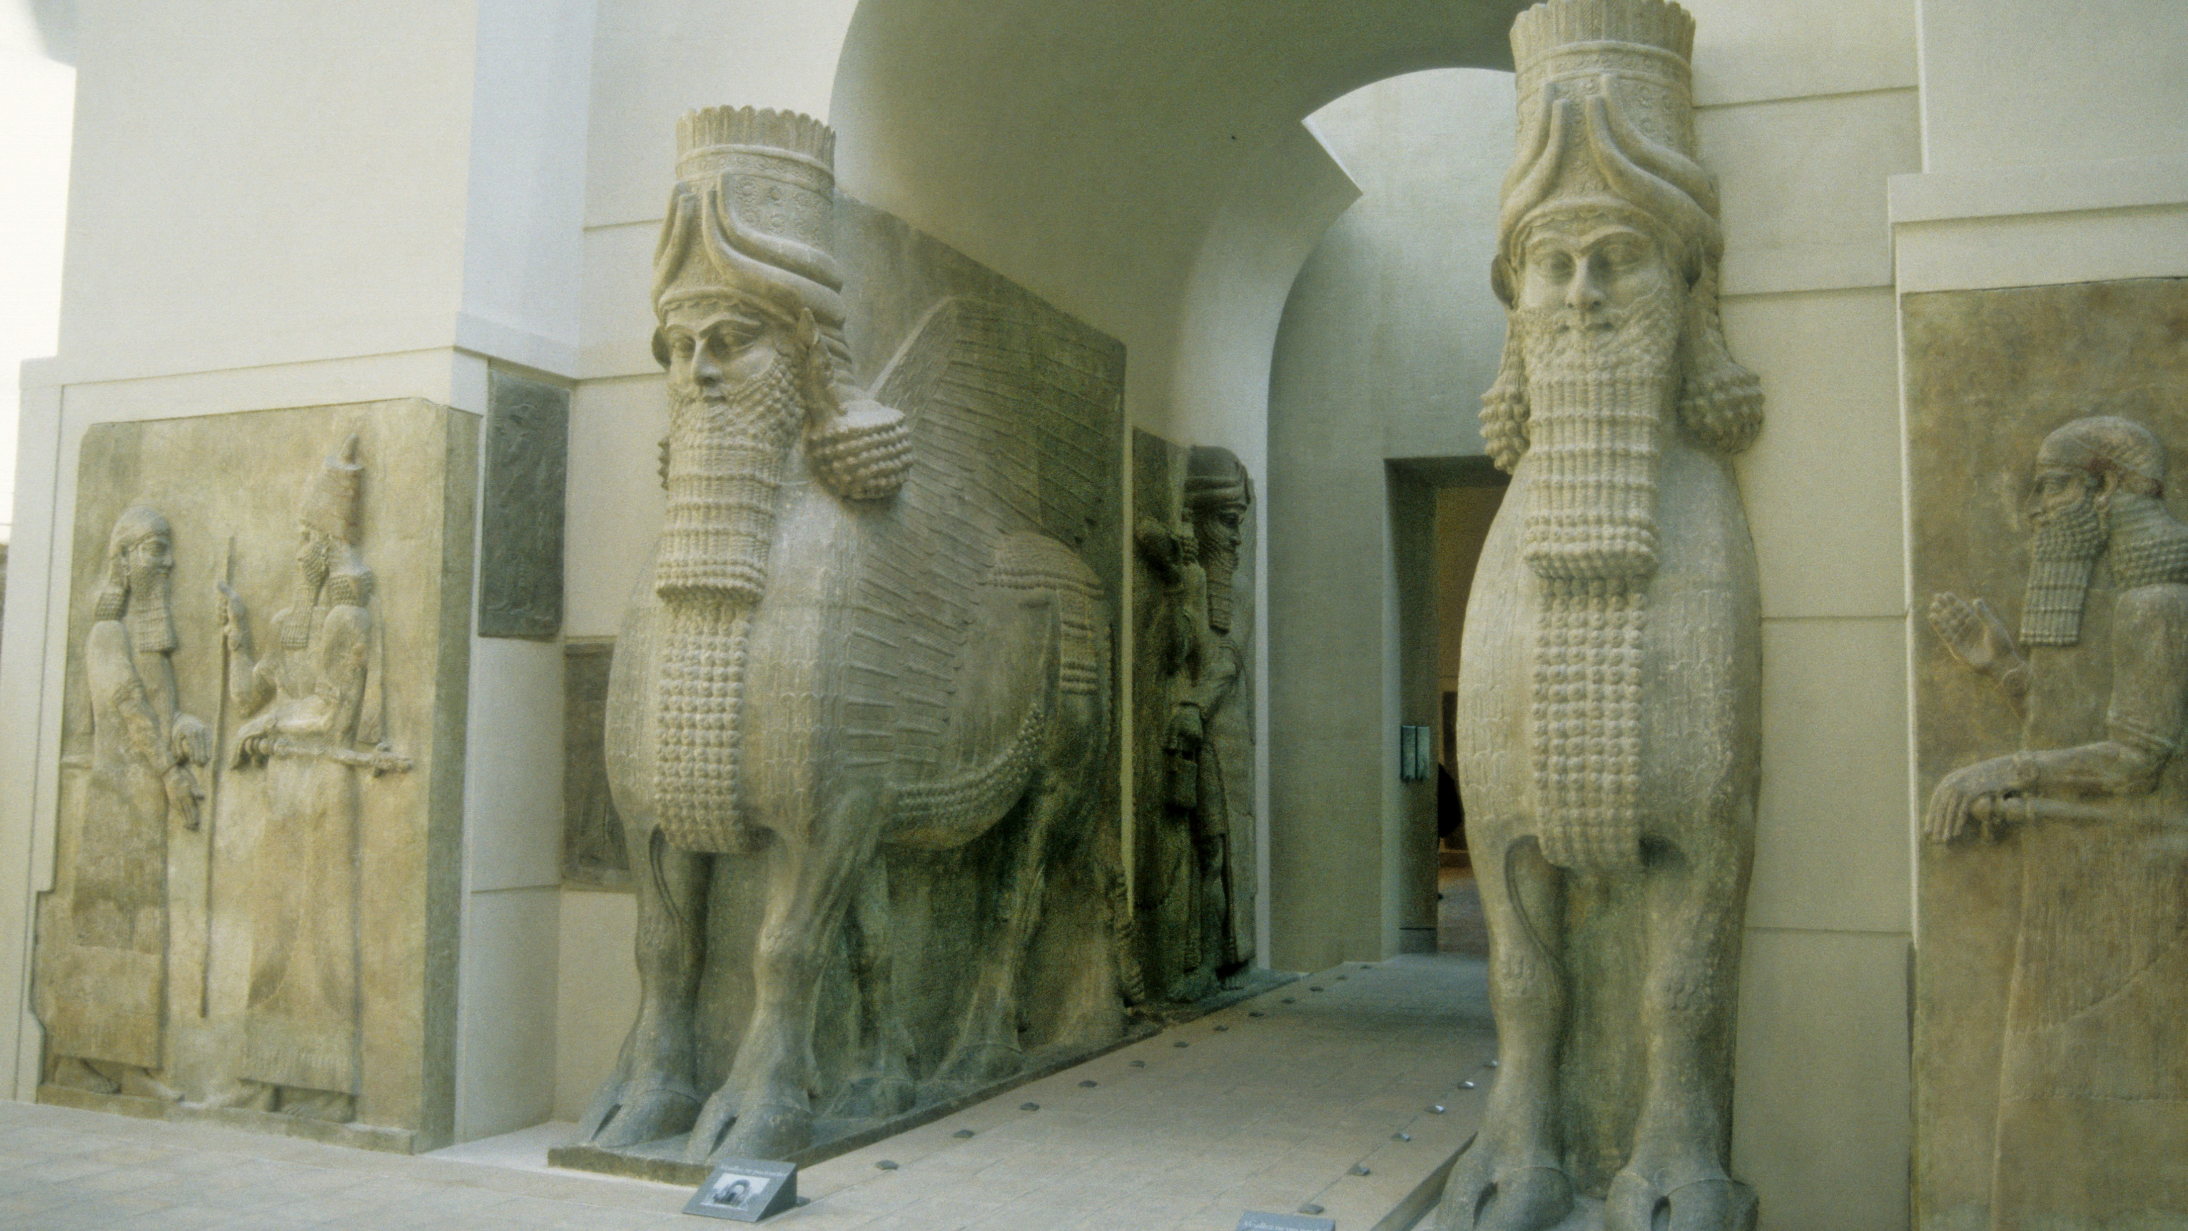
Dur-Sharrukin:
Palace sculptures

Slide 37
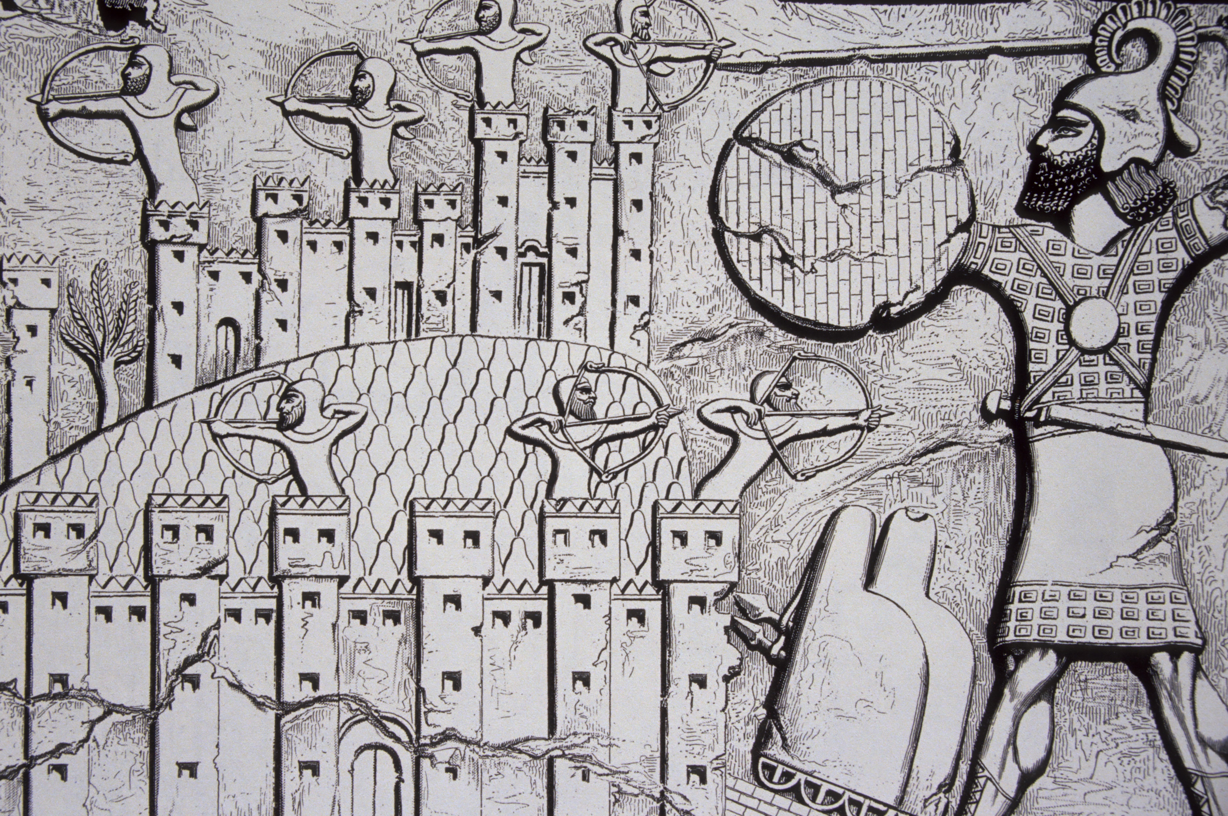
Dur-Sharrukin:
Gaza attacked

Slide 38
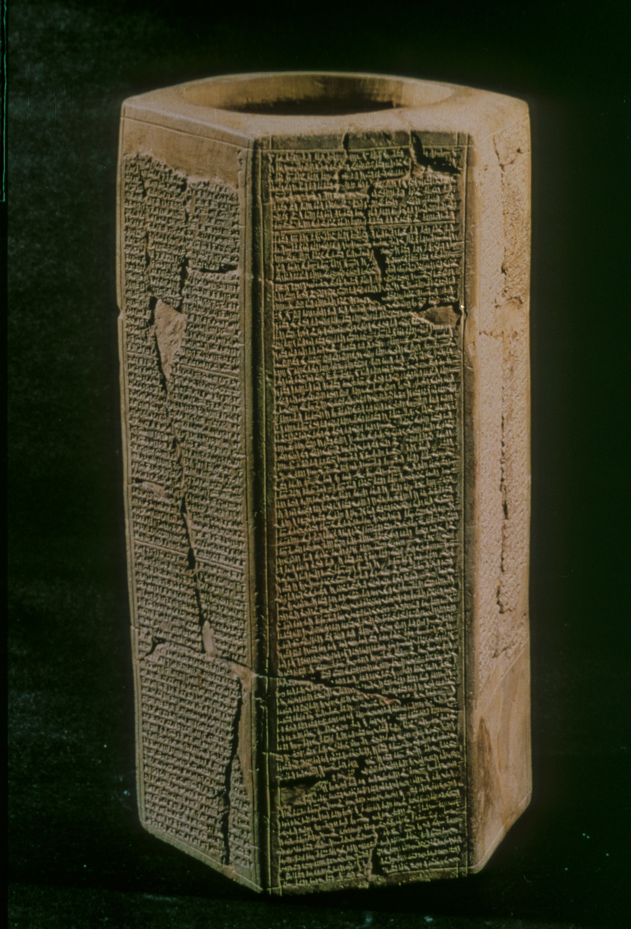
Prism of Sennacherib

Slide 39
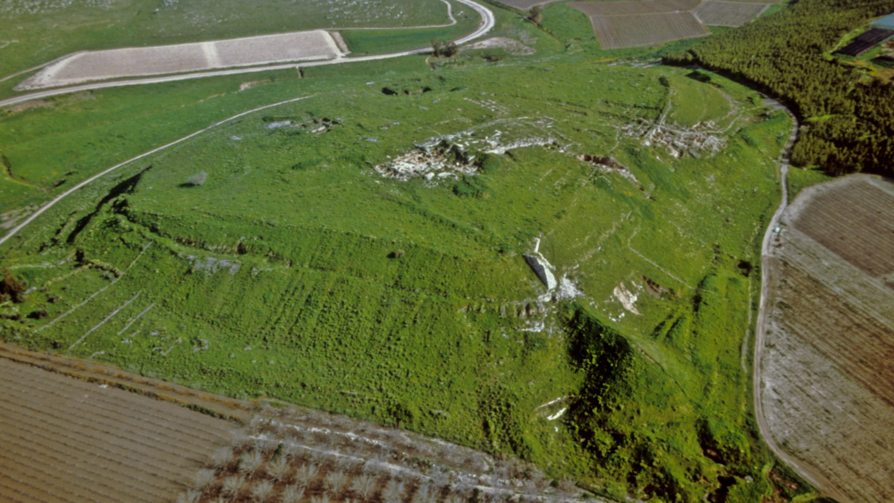
Lachish

Slide 40
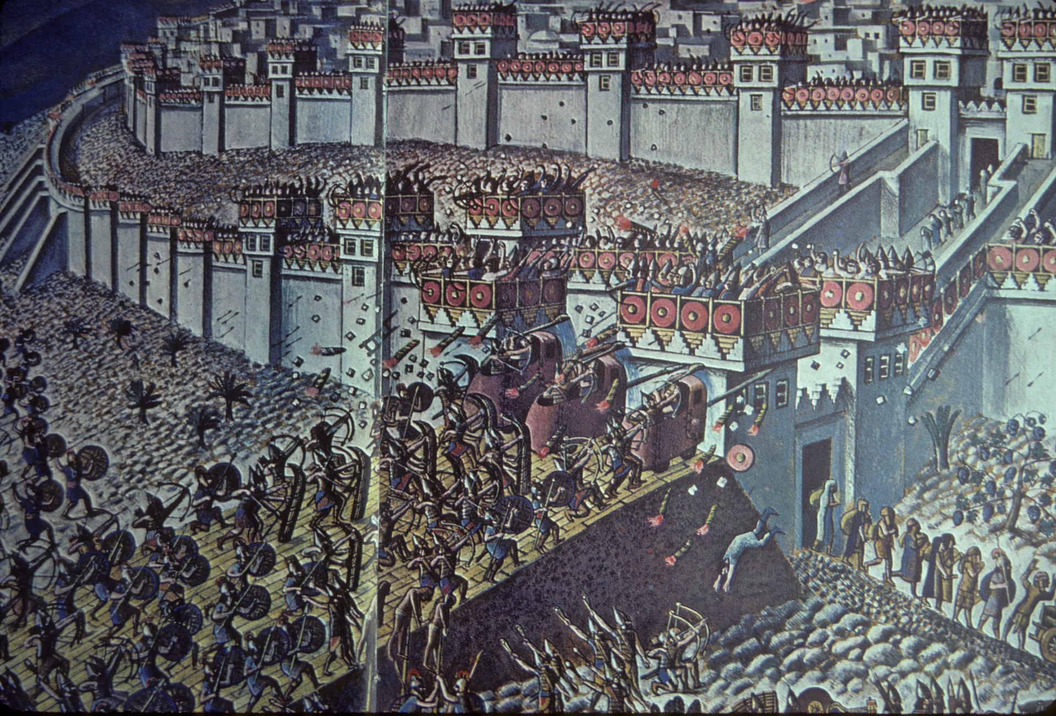
Lachish

Slide 41
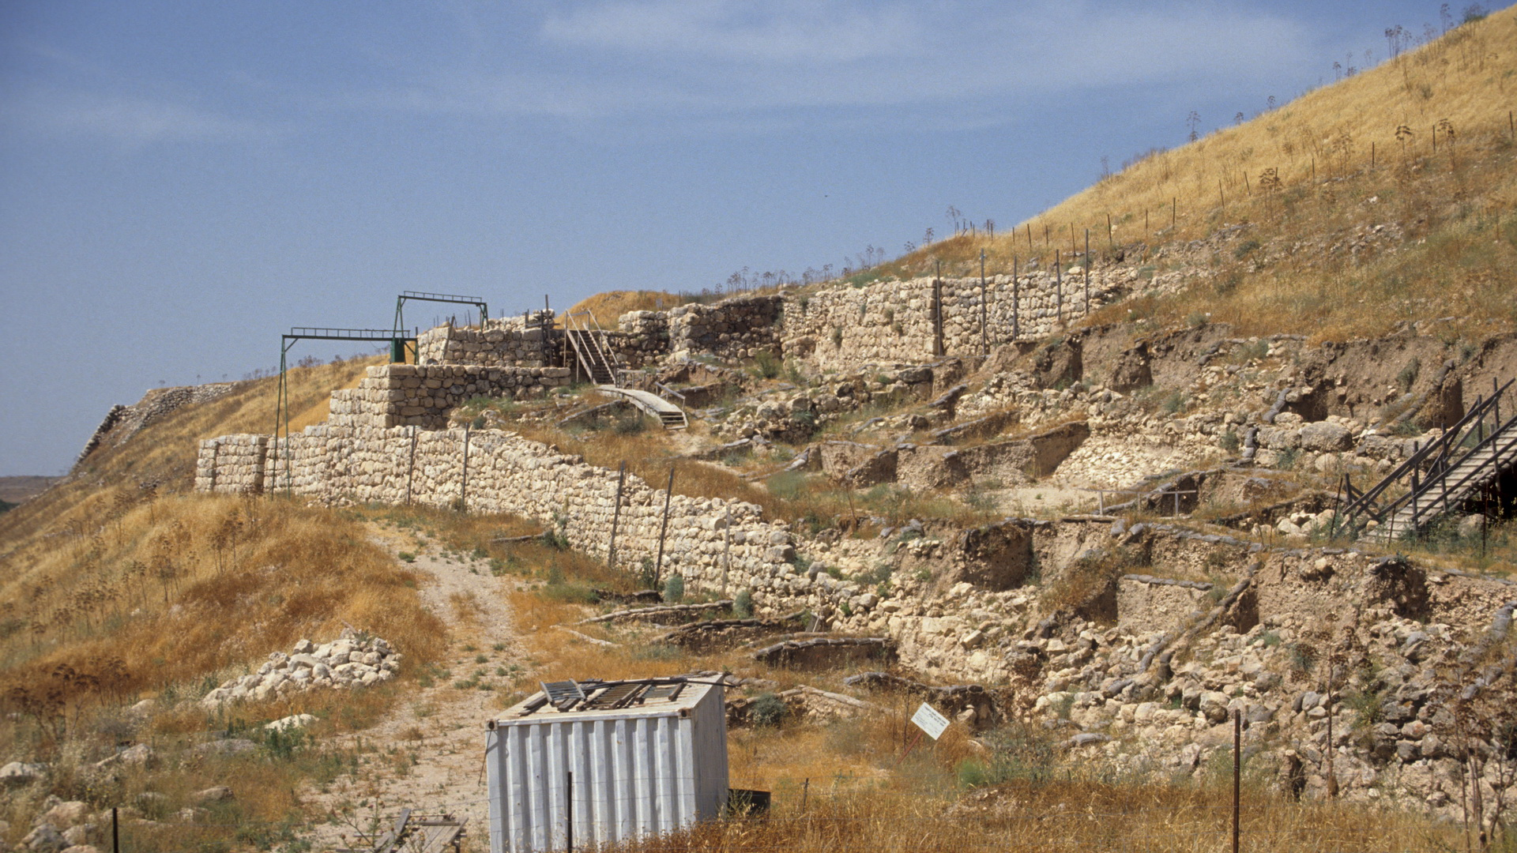
Lachish
(Daniel C Browning Jr, 1985)

Slide 42
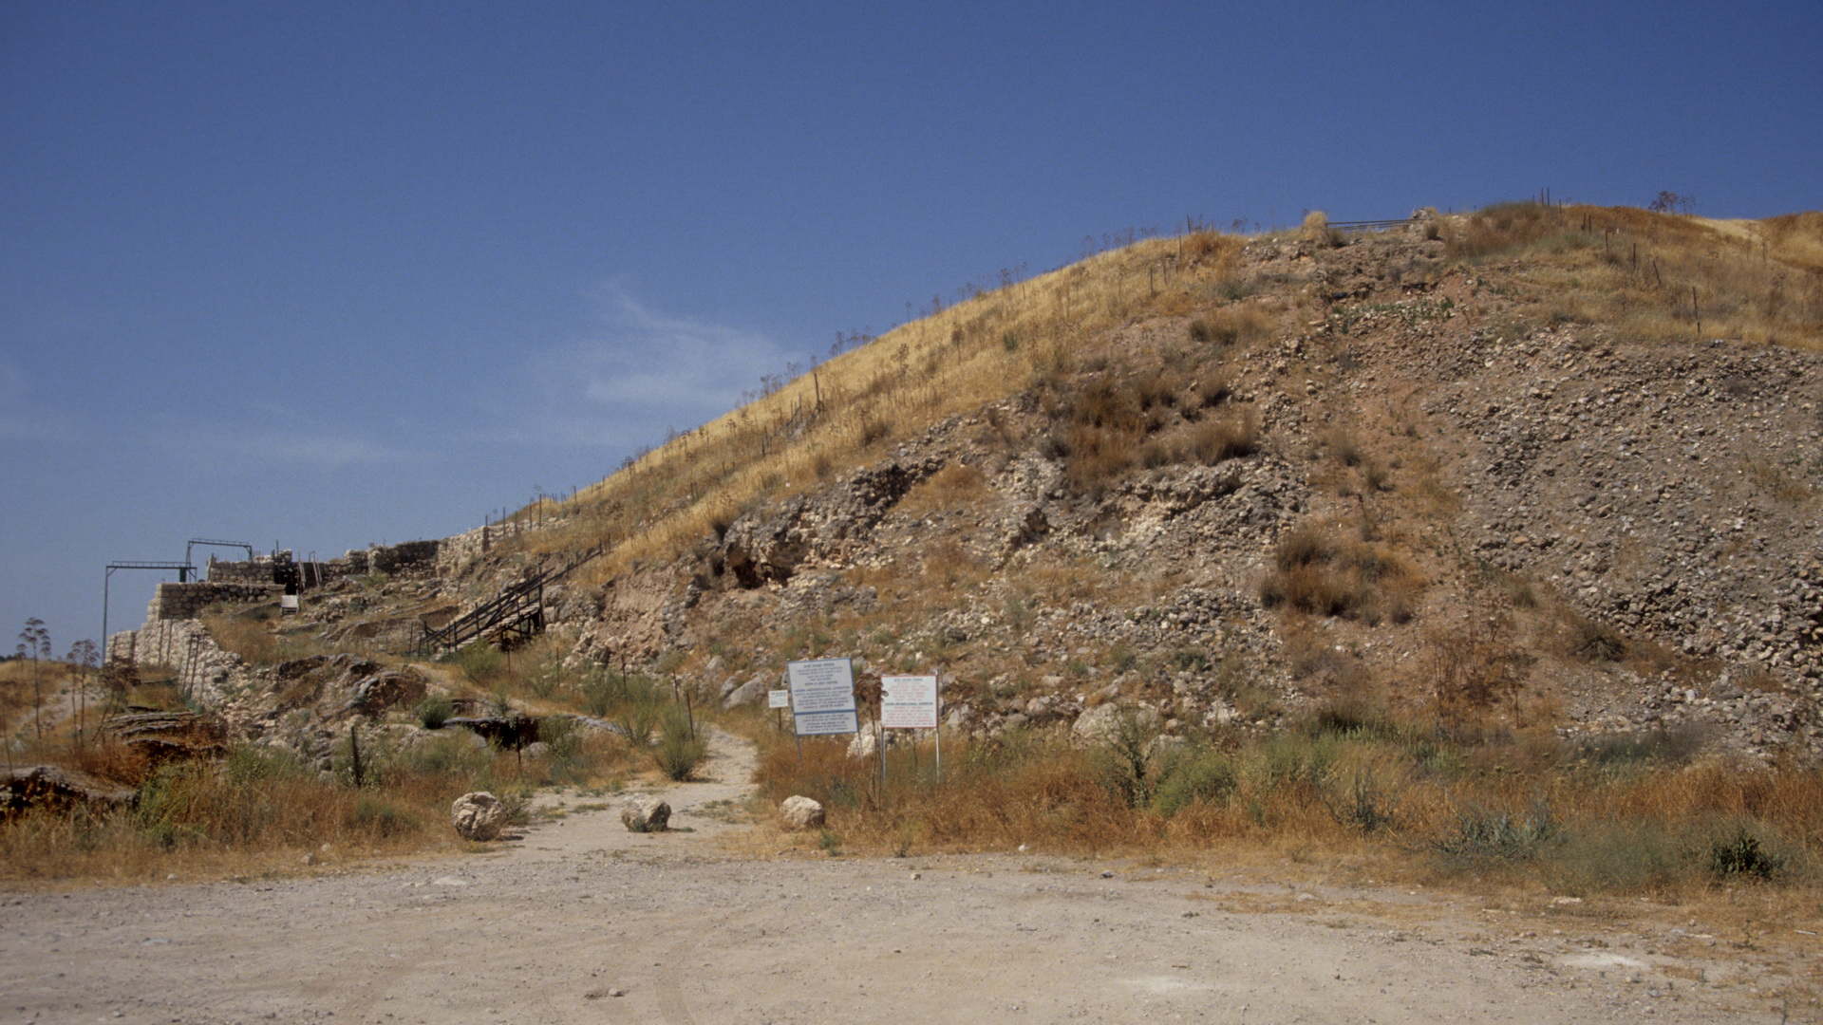
Lachish
(Daniel C Browning Jr, 1985)

Slide 43
Basic Outline of Hebrew Bible History
PATRIARCHS: Abraham, Isaac, Jacob & sons (Middle Bronze Age)
SOJOURN IN EGYPT: move to Egypt under Joseph, eventual enslavement (Late Bronze Age)
EXODUS: Moses leads Israelites from Egypt, Mosaic Law at Sinai (End of Late Bronze Age)
CONQUEST: Joshua leads military invasion of Canaan, the “Promised Land” (Beginning of Iron Age)
JUDGES: Israel in tribal organization with local rule, struggle with other nations (Early Iron Age)
UNITED MONARCHY: 1st king over all Israel, Saul, superseded by David & Solomon (c. 1000-925 bc)
DIVIDED MONARCHY: after Solomon; Judah remains under Davidic dynasty, N tribes = Israel
JUDAH ALONE: Israel destroyed by Assyria (722 bc); Judah as vassal to Assyria, later Babylon
EXILE: Judah rebelled; Jerusalem/Temple destroyed by Babylon; most “Jews”/Judeans exiled to Babylon
POST-EXILIC PERIOD: after Babylon taken by Persians, Cyrus allows Jews to return, rebuild Temple; but Judah remains a province in the Persian (Achaemenid or “Medo-Persian”) Empire

Slide 44
The Iron Age in the Near East, Egypt, & E Mediterranean
(c. 1200-333 bce)
Appox Dates bce | EGYPT | SYRIA-PALESTINE | GREECE | ANATOLIA | MESOPOTAMIA
1200-900 | Weak continuation of New Kingdom 3rd Intermediate Period Shoshenq (Shishak) I c. 925 bce | Rise of New Nations Phoenicians Philistines Arameans Moab & Edom Israel | Dark Age Migration of Greek groups | Greek Colonists in Aegean Coast Neo-Hittite States in SE | Middle Assyrian Period Neo-Hittite States in NW Rise of Aramean City-States N and NW Babylon continues in S
900-550 | Struggle with Assyria/ Babylon | Israel and Judah Domination by Assyria/Babylon | Archaic Period More Colonies | Domination by Assyria/Babylon | (Neo-)Assyrian Empire (Neo-)Babylonian Empire
550-333

Slide 45
The Iron Age in the Near East, Egypt, & E Mediterranean
(c. 1200-333 bce)
Appox Dates bce | EGYPT | SYRIA-PALESTINE | GREECE | ANATOLIA | MESOPOTAMIA
1200-900 | Weak continuation of New Kingdom 3rd Intermediate Period Shoshenq (Shishak) I c. 925 bce | Rise of New Nations Phoenicians Philistines Arameans Moab & Edom Israel | Dark Age Migration of Greek groups | Greek Colonists in Aegean Coast Neo-Hittite States in SE | Middle Assyrian Period Neo-Hittite States in NW Rise of Aramean City-States N and NW Babylon continues in S
900-550 | Struggle with Assyria/ Babylon | Israel and Judah Domination by Assyria/Babylon | Archaic Period More Colonies | Domination by Assyria/Babylon | (Neo-)Assyrian Empire (Neo-)Babylonian Empire
550-333 | Late Period | Persian Domination |  | Persian Domination

Slide 46
The Iron Age in the Near East, Egypt, & E Mediterranean
(c. 1200-333 bce)
Appox Dates bce | EGYPT | SYRIA-PALESTINE | GREECE | ANATOLIA | MESOPOTAMIA
1200-900 | Weak continuation of New Kingdom 3rd Intermediate Period Shoshenq (Shishak) I c. 925 bce | Rise of New Nations Phoenicians Philistines Arameans Moab & Edom Israel | Dark Age Migration of Greek groups | Greek Colonists in Aegean Coast Neo-Hittite States in SE | Middle Assyrian Period Neo-Hittite States in NW Rise of Aramean City-States N and NW Babylon continues in S
900-550 | Struggle with Assyria/ Babylon | Israel and Judah Domination by Assyria/Babylon | Archaic Period More Colonies | Domination by Assyria/Babylon | (Neo-)Assyrian Empire (Neo-)Babylonian Empire
550-333 | Late/ Persian Periods | Persian Domination | Persian Wars | Persian Domination

Slide 47
The Later Iron Age in the Near East, Egypt
SUMMARY: Assyrian and Babylonian Empires (c. 900-500 bce)
9th through 7th centuries bce dominated by Assyria
Assyria’s capital Nineveh fell in 612 bce to coalition of Babylon and Medes
Babylon (Chaldeans) and Egypt contend for dominance; Battle of Carchemish in 605 bce makes Babylon and King Nebuchadnezzar masters of Near East
Babylon’s king Nebuchadnezzar ends Judah, destroys Jerusalem (& Jewish Temple), deports Jews into Exile
Babylon (& empire) falls 539 bce to Medo-Persian King Cyrus the Great, establishing Achaemenid Persian Empire; Jews allowed to return, rebuild; but remained Persian province

Slide 48
Achaemenid Persian Empire (550-333 bce)
Formed by King Cyrus the Great (559-530 bce)
  Union of Indo-European groups: Medes (greatest king = Cyaxeres) and Persians (founder = Achaemenes)
  Cyrus II was Persian/Median: son of Persian king Cambyses by daughter of Median king Astyages
  defeated grandfather Astyages, united Persians and Medes
  539 bce: Babylon (& empire) falls to Cyrus; establishing Achaemenid Persian Empire
    Jews allowed to return, rebuild; but remained Persian province through the end of Hebrew Bible
Cambyses II (529-522): killed brother to take throne; conquered Egypt; back home, throne seized by pretender (fake brother); Cambyses stabbed self on the way to deal with situation . . .
Darius I (521-486): took throne from pretender; expanded empire; began building capital Persepolis
  Administrative reform: satraps governed satrapies (provinces); standard coinage, postal service
  Began wars with Greece (“Persian Wars”)
    Ionian cities in Western Asia Minor (Aegean coast) revolt (499-494)
    492: punitive expedition shipwrecked at Mt Athos
    490: Darius crosses Hellespont, invades Greece, Battle of Marathon
Xerxes I (485-465)
  war with Greece in 480
    Battle of Thermopylae; Athens burned
    Battle of Salamis: Persians defeated by Athens in major naval battle
  Final defeat at Plataea (479)

Slide 49
Persian Cultural Influence
Multi-ethnic Culture and Tolerance of Beliefs
Government
  Provinces ruled by civil servant officials
  Roads, postal system, standard coinage
Religion
  Zoroastrianism
    Emphasis on single deity, Ahura Mazda
    Dualism
    Eternal reward/punishment (i.e., Heaven/Hell)
  Mithraism
    Astral origins
    Led to new “mystery religion” based on myth with “membership,” initiation, ceremonies, etc.

