Slide 1
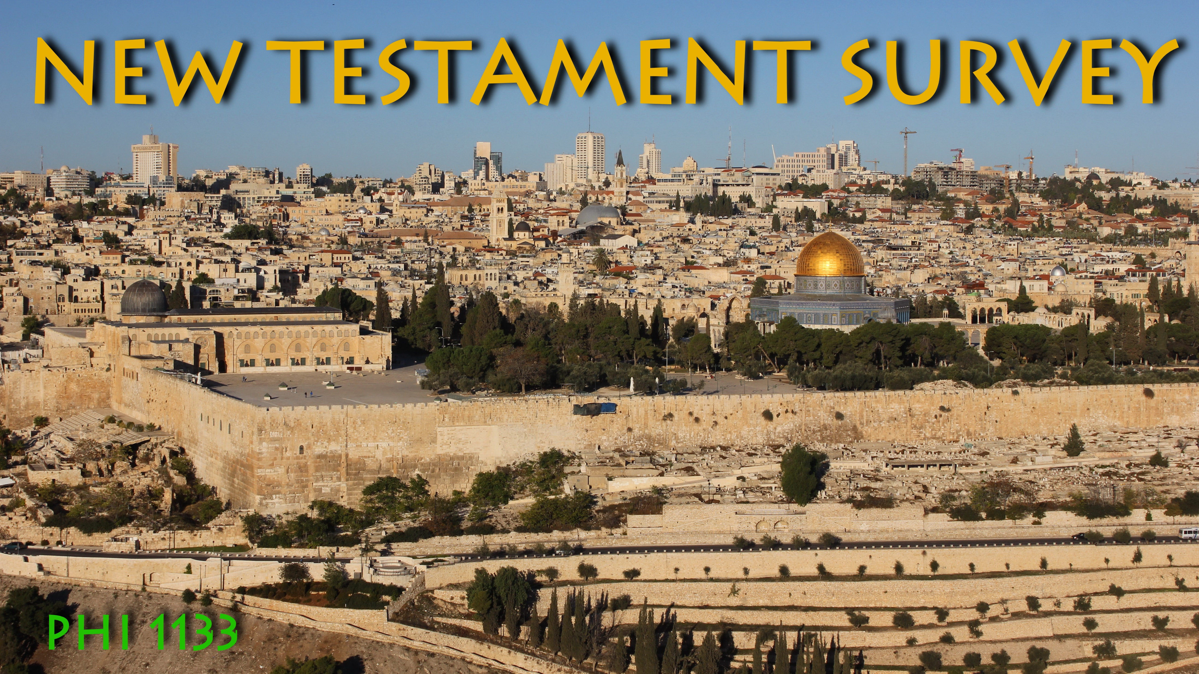
How did we get the
New Testament?

Slide 2
The New Testament Canon
Canon (from a word meaning “measuring rod”) = A List of Writings Considered to be Authoritative
NT Canon = The List of Books Considered to be officially part of the New Testament
How was the NT Canon Determined?

Slide 3
Formation of NT Canon
NT Canon Began to Form by early 2nd Century
  “The Gospel” = 4 canonical gospels; “The Apostle” = Paul’s letters
  Heretic Gnostic teacher Marcion (ca. AD 140): First (& restricted) canon
    Luke = only gospel; even it was shortened . . . + Only Paul’s letters
    Marcion prompted debate on orthodox position
  Hebrews, James, Jude, 2 Peter, 2-3 John, and Revelation disputed for 2 centuries . . .
  1st list of final 27 NT books: Athanasius’ Festal Letter of Easter, 367
  Criteria by Which New Testament Books were Canonized
  Authorship by an Apostle or a Close Associate
  An Inherent Spiritual Quality or Authority (it changed lives)
  General Recognition; Accepted by the Majority of Churches
  Which comes first: Canonicity or Authority?

Slide 4
New Testament Apocrypha
  Books related to NT in content, but not included in Canon
  Generally written 2nd century or later
  Many are pseudonymous (“falsely named”); i.e., falsely attributed to a biblical character
  Some = good works that never found general acceptance
  Not a collection with defined limits
  Gospels
  Acts
  Letters
  Apocalypses
  Allegories and Gnostic books

Slide 5
The New Testament Text
Text and Manuscripts
Textual Criticism
Variants in the NT Text

Slide 6
Text and Manuscripts
The Text = the wording; the exact words and their order
State of the New Testament Text
  NT Text Completed by AD 100
  The Bad News: None of the Autographs survive
    Autographs = “self writing” = hand-written originals
  The Good News: over 5000 Greek Manuscripts (mss) exist . . .

Slide 7
Text and Manuscripts
EARLIEST = PAPYRUS MSS
  Papyrus = paper like material, made from reed plant, main writing material in antiquity
  Early mss are fragmentary; poorly preserved, sections of NT
  Some are scrolls; most are codices (codex = book like stack of leaves sewn on edge)
  Mss designated by p + number
EARLIEST COMPLETE = UNCIAL MSS
  Codex form, often no spaces between words, no punctuation
  Named for “Uncial” capital forms of letters popular in 4th-6th century; all caps
  Mss designated by capital letter
LATER MINISCULE MSS
  “Miniscule” = lower case letter forms popular in late antiquity-Medieval period
  Designated by Arabic numerals

Slide 8
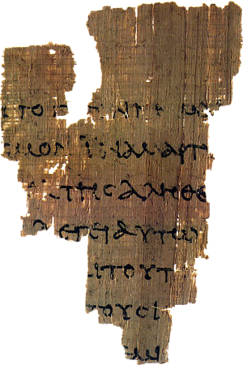
Text and Manuscripts
EARLIEST
PAPYRUS MSS
John Rylands Fragment
= p⁵²

Slide 9
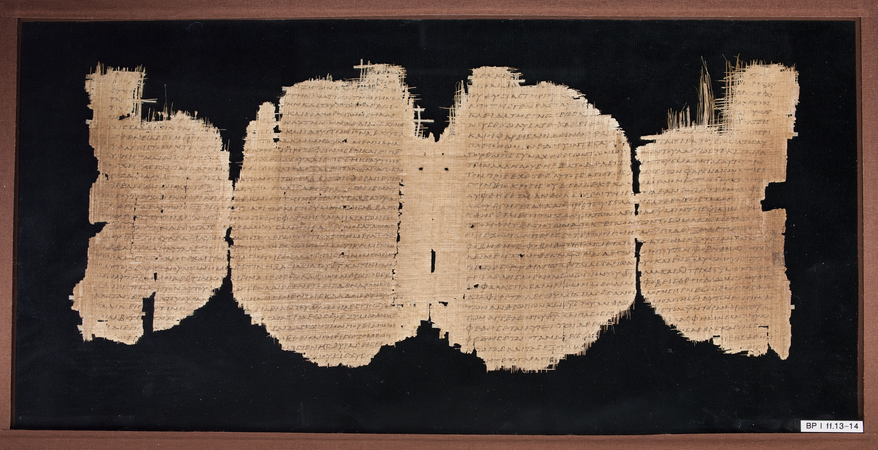
EARLY PAPYRUS MSS Chester Beatty Papyri (mostly 3rd c. ad)
Chester Beatty Papyrus I = p⁴⁵

Slide 10
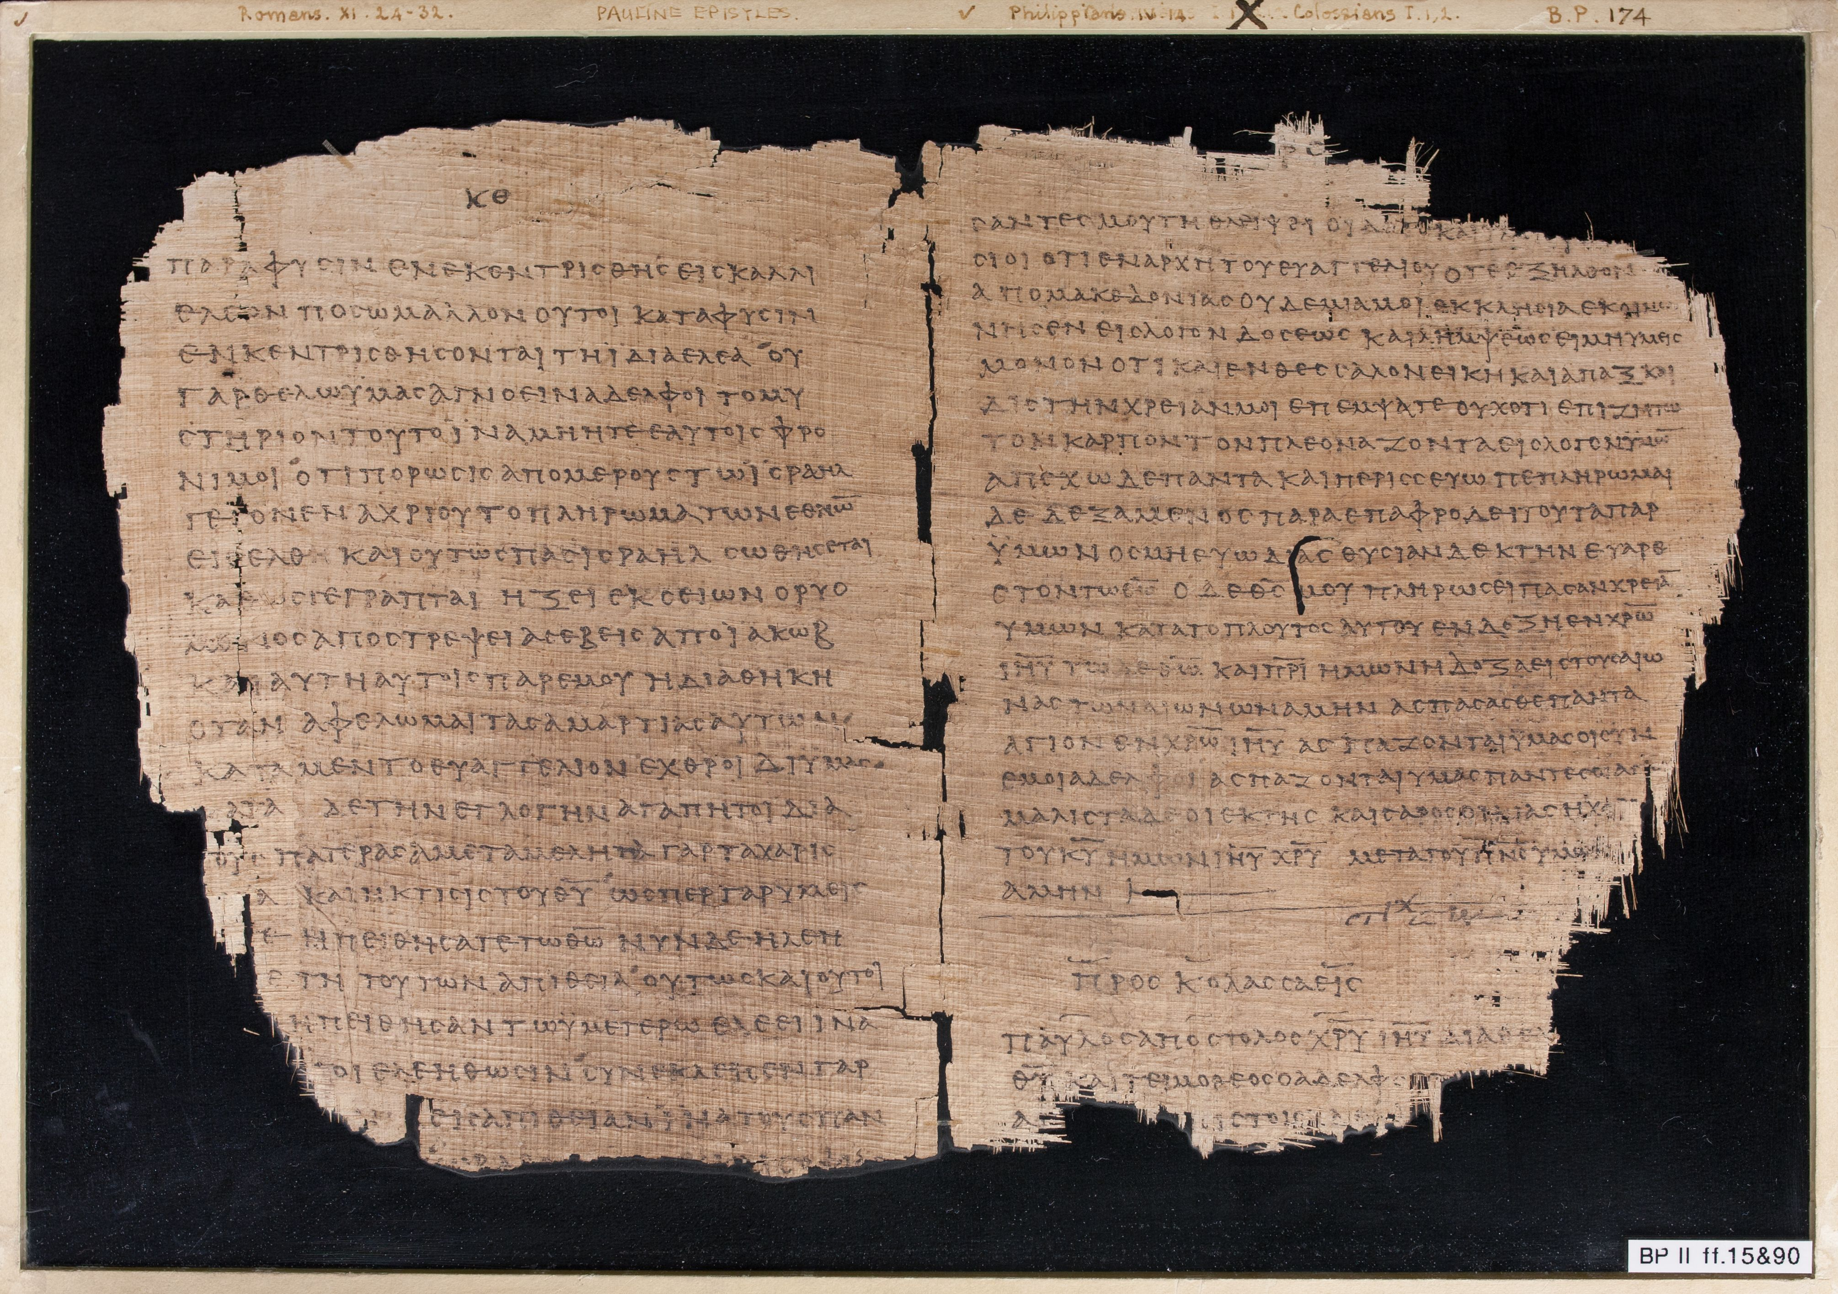
EARLY PAPYRUS MSS Chester Beatty Papyri (mostly 3rd c. ad)
Chester Beatty Papyrus II = p⁴⁶

Slide 11
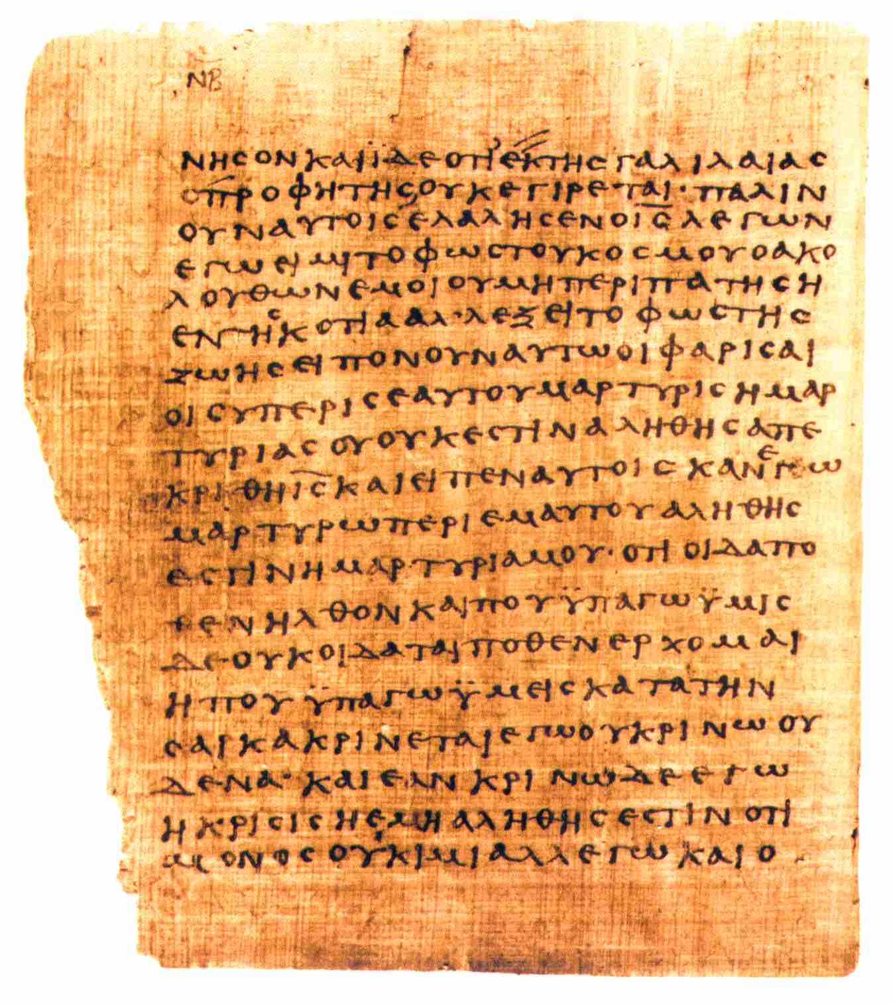
EARLY PAPYRUS MSS Bodmer Library Collection (mostly 3rd c. ad)
Papyrus Bodmer II = p⁶⁶

Slide 12
Text and Manuscripts
EARLIEST COMPLETE = UNCIAL MSS
  Codex form, often no spaces between words, no punctuation
  Named for “Uncial” capital forms of letters popular in 4th-6th century; all caps
  Mss designated by capital letter

Slide 13
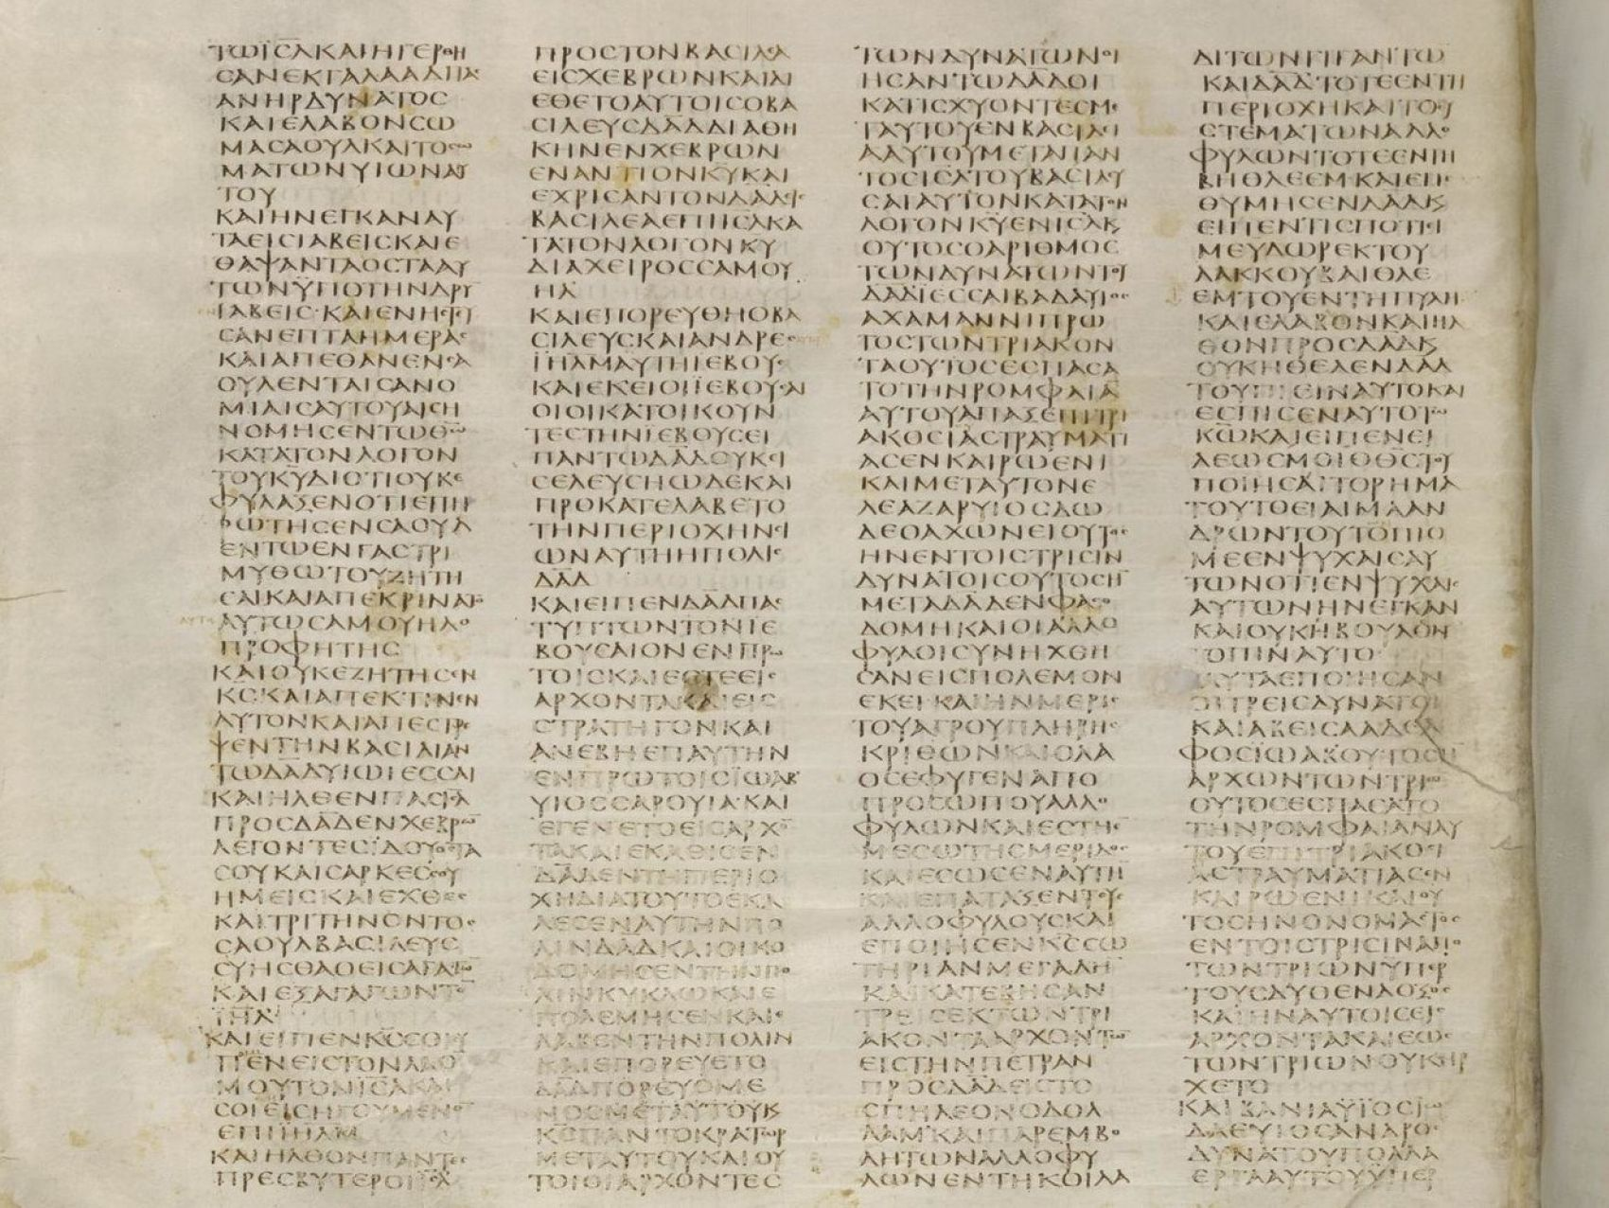
UNCIAL MSS
Codex Sinaiticus = ) (4th century)

Slide 14
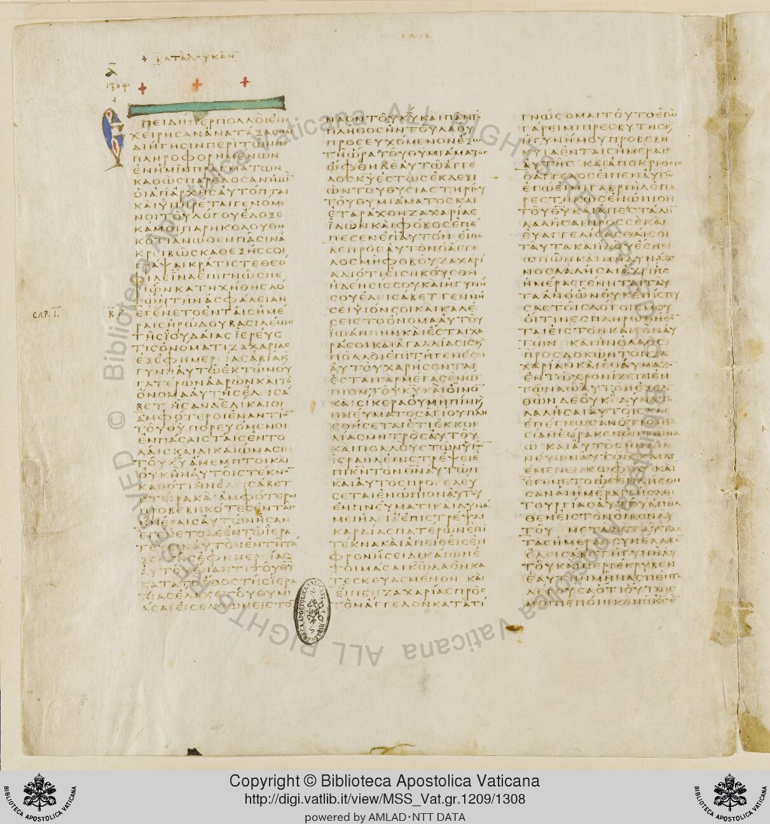
UNCIAL MSS
Codex Vaticanus = B (4th century)

Slide 15
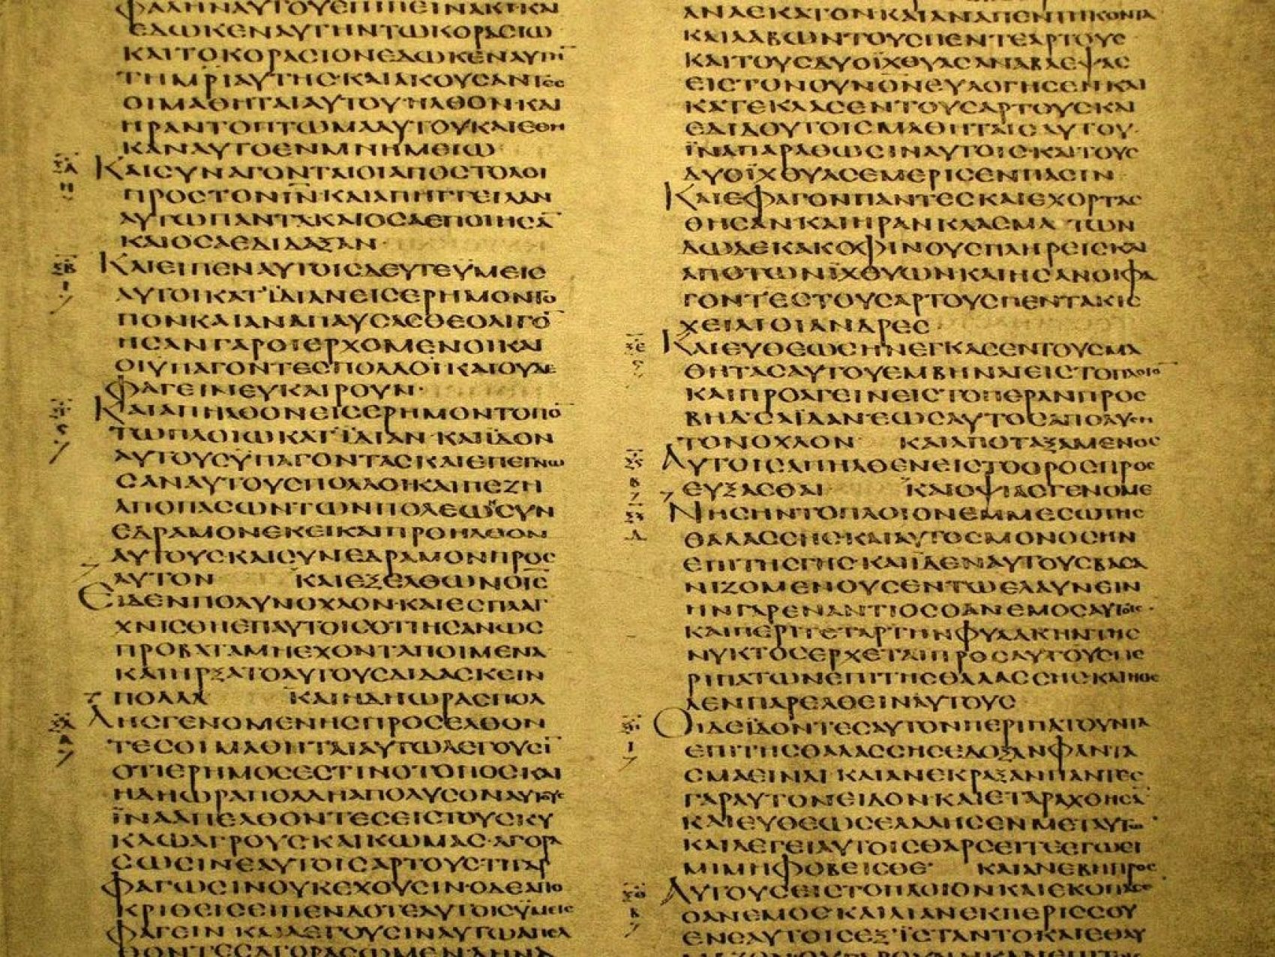
UNCIAL MSS
Codex Alexandrinus = A (5th century)

Slide 16
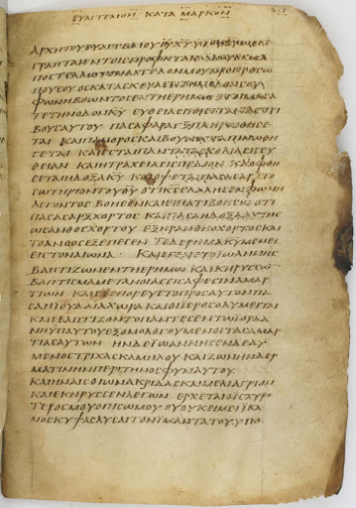
UNCIAL MSS
Washington Gospels = W (4th-5th century)

Slide 17
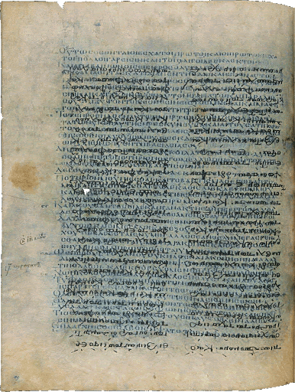
UNCIAL MSS
Codex Ephraemi = C
(5th century)
a palimpsest = reused ms; written over
the parchment ms was reused in the 12th century for a work of St. Ephraem

Slide 18
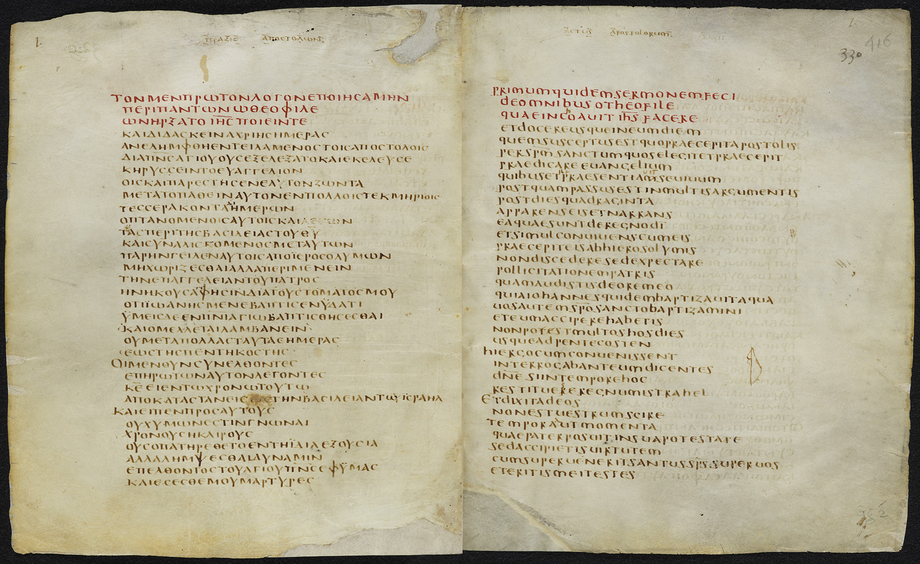
UNCIAL MSS
Codex Bezae
= D (5th-6th century)

Slide 19
Text and Manuscripts
LATER MINISCULE MSS
  “Miniscule” = lower case letter forms popular in late antiquity-Medieval period
  Designated by Arabic numerals

Slide 20
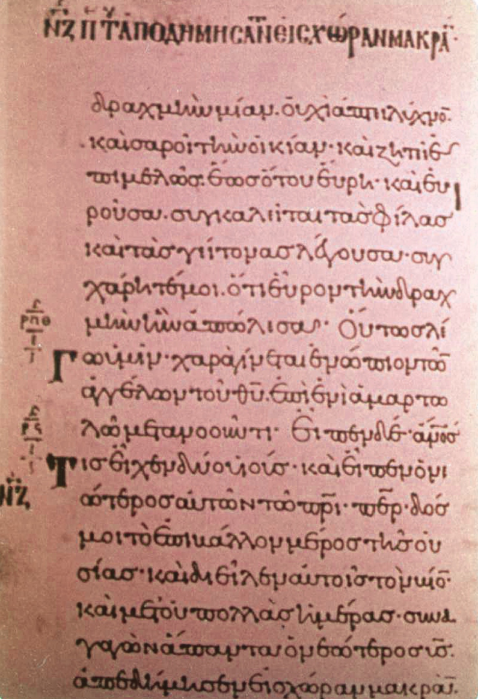
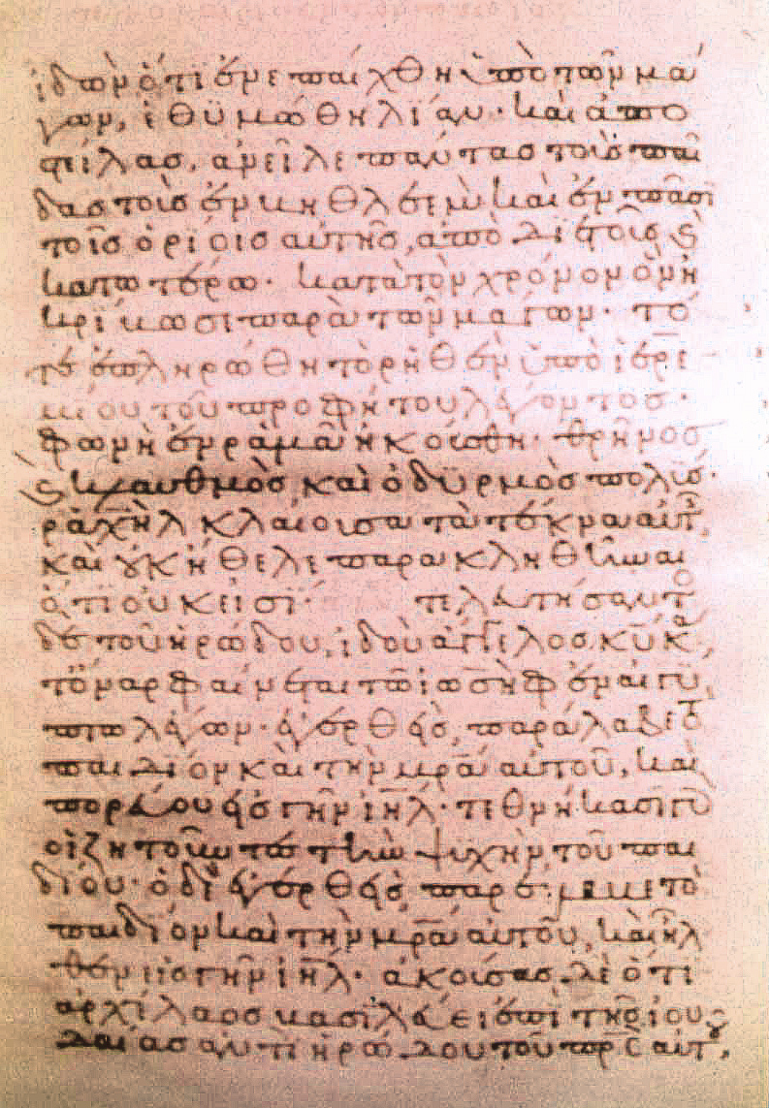
MINISCULE MSS
Gregory number 14
(10th century)

Slide 21
The New Testament Text
Text and Manuscripts
Textual Criticism

Slide 22
Textual Criticism
Textual Criticism = the effort to restore the original reading of a text
A scholarly process done on any text for which . . .
  The original (autograph) does not exist
  Multiple MSS copies exist that do not agree exactly
The New Testament is the best and most extensive example

Slide 23
The New Testament Text
Text and Manuscripts
Textual Criticism
Variants in the NT Text

Slide 24
Variants in the NT Text
Variants = differences between MSS of the same text
Early copying done for local congregations
Paul encouraged copying (Col 4:16)
Copying by amateurs; variants are unintentional errors
Most variants created by 4th century
Later, some changes made for doctrinal or other reasons; variants are intentional
Variants fall into broad geographical groups:
Syrian/Byzantine; Alexandrian; Western

Slide 25
Unintentional Changes (Errors)
Errors of sight: from reading incorrectly
  Wrong Division of Words: Fusion and Fission
  Confusion of Similar Letters (Α, Λ, Δ; Ο, Θ; ζ, ξ)
  Homoeoteleuton (“similar ending”): Omission caused by similar endings of words/phrases
  Homoeoarchton (“similar beginning”): Omission caused by similar beginnings of words/phrases
  Haplography (“single writing”): Writing once (word or letter) what should be written twice
  Dittography (“writing twice”): Writing twice what should be written once
  Metathesis (“change of place”): Transposition of words or phrases

Slide 26
Unintentional Changes (Errors)
Errors of Writing (spelling, etc.): similar to various errors of sight, but in the writing process
Errors of Hearing: Homophony; certain words were pronounced alike
Errors of Memory
Errors of Judgement: e.g., inclusion of marginal note into text (John 5:4??)

Slide 27
Variant Examples
Homoioteleuton (“similar ending”)
John 17:5
“I do not ask that you take them from the world, but that you keep them from evil.”
“I do not ask that you take them from the world, but that you keep them from evil.”

Slide 28
Variant Examples
Homoioteleuton (“similar ending”)
John 17:5
“I do not ask that you take them from evil.”

Slide 29
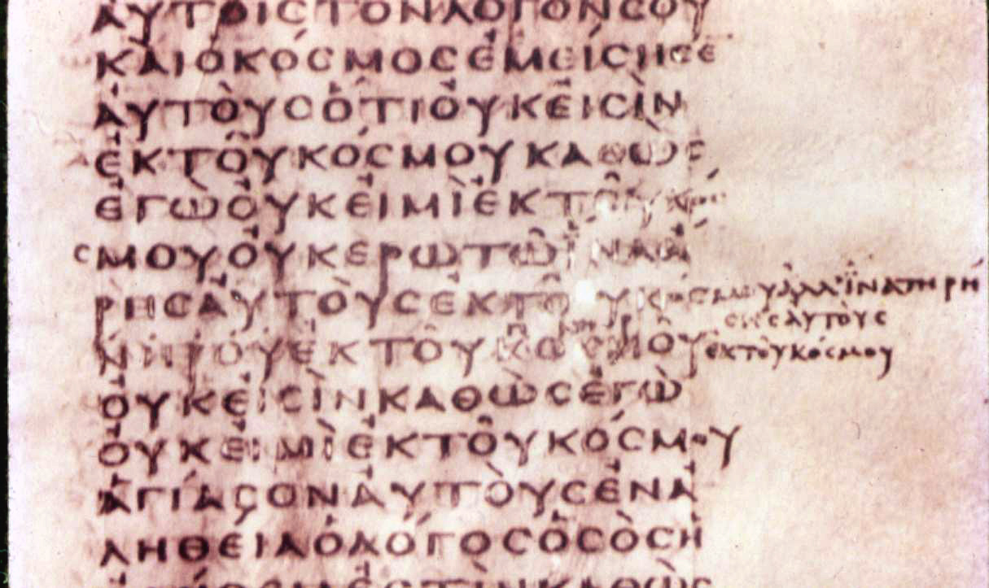
Variant Examples
Homoioteleuton
John 17:5
B
AUTOUS = “them”
Later scribe’s
correction

Slide 30
Intentional Changes
Grammatical/linguistic changes
Liturgical changes
Elimination of discrepancies
Harmonization
Conflation
Attempts to correct a MS error
Doctrinal changes
Complementary word additions

Slide 31
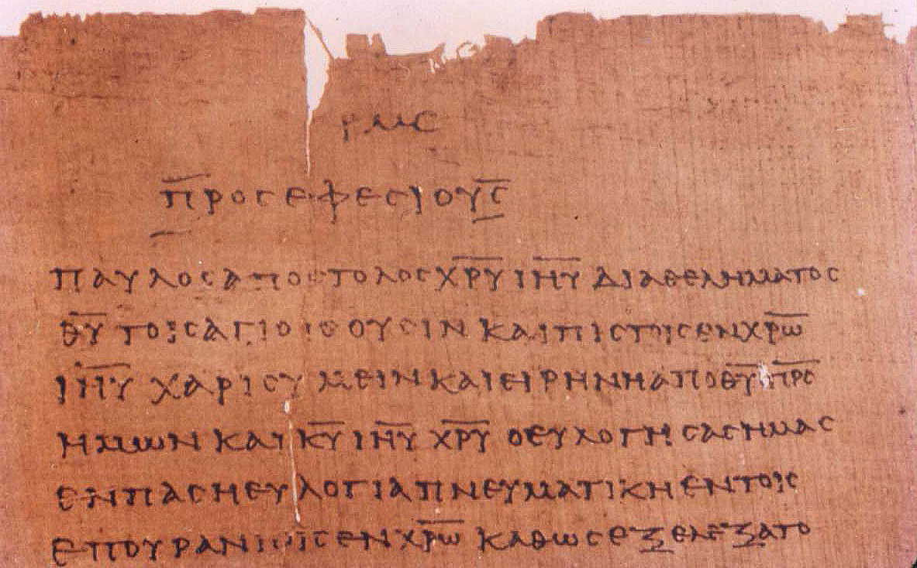
Variant Examples
p⁴⁶
Pros Efesiouj = to the Ephesians
Pauloj apostoloj Xru Ihu dia qelhmatoj
Paul, apostle of Christ Jesus through (the) will
Qu toij agioij ousin kai pistoij en Xrw
(of) God to the saints (who) are also faithful in Christ
Ihu . . .
text does not contain “in Ephesus”

Slide 32
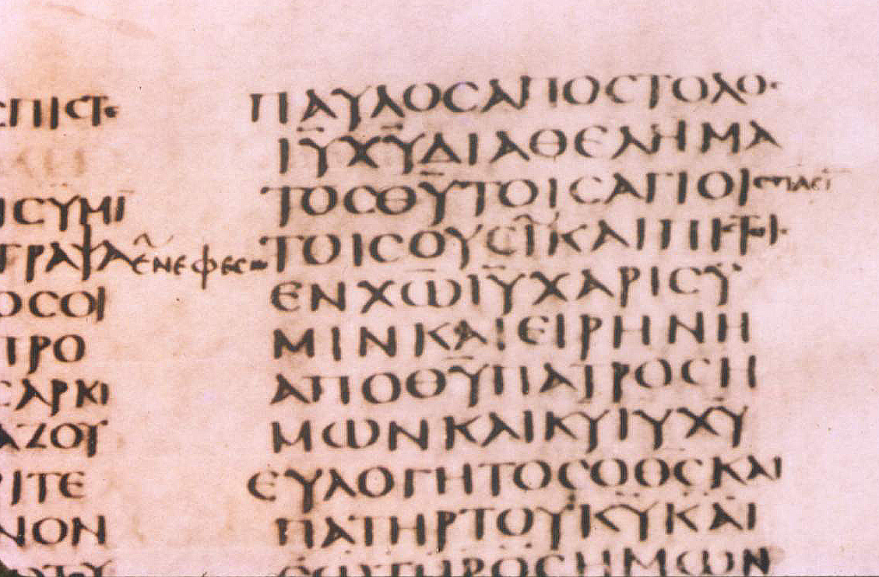
Variant Examples
Pauloj apostoloj
)
. . . Qu toij agioij
pasin = “to all”
En Efesw = “in Ephesus”

Slide 33
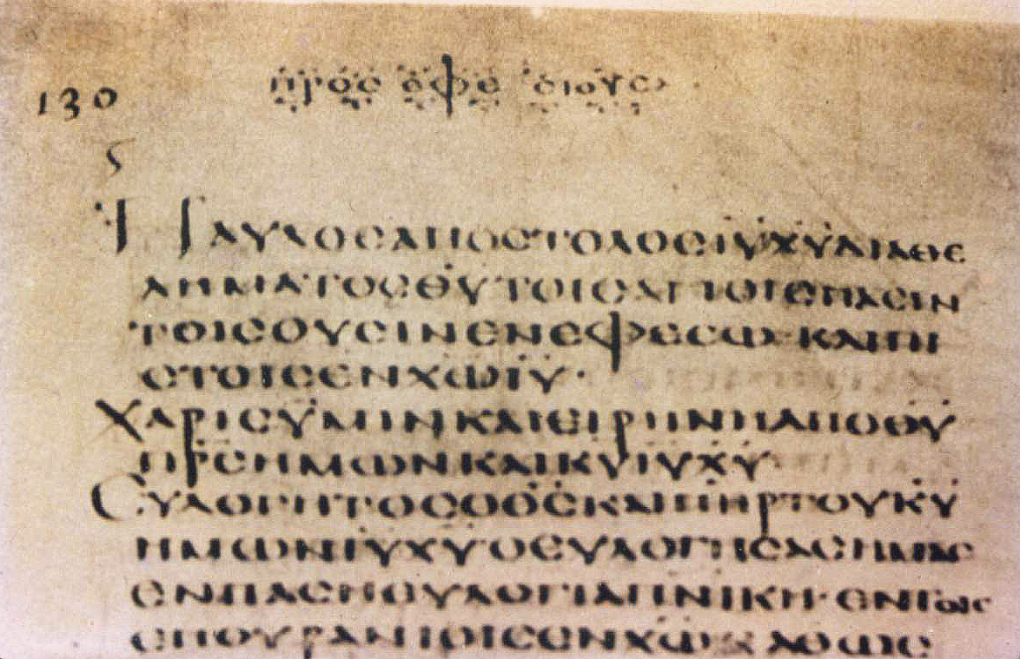
Variant Examples
Pros Efe siouj = to the Ephesians
A
pasin = “to all”
En Efesw = “in Ephesus”

Slide 34

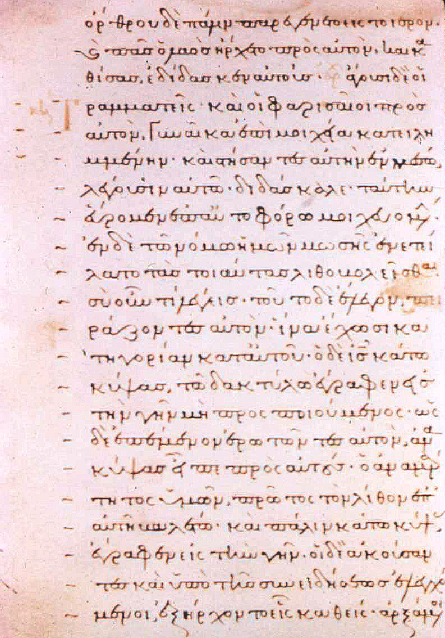
The woman caught in adultery
(John 7:53-8:11)
absent in earliest MSS
first appears in D
some MSS place in Luke
Isaac Gospels; 14th cent. →
marked here as dubious by lines in left margin

Slide 35
Variant Examples
OTHER EXAMPLES OF LENGTHY “ADDITIONS” TO TEXT
Pool of Bethesda (John 5:2-5)
The ending of Mark (Mk 16:9-20)

Slide 36
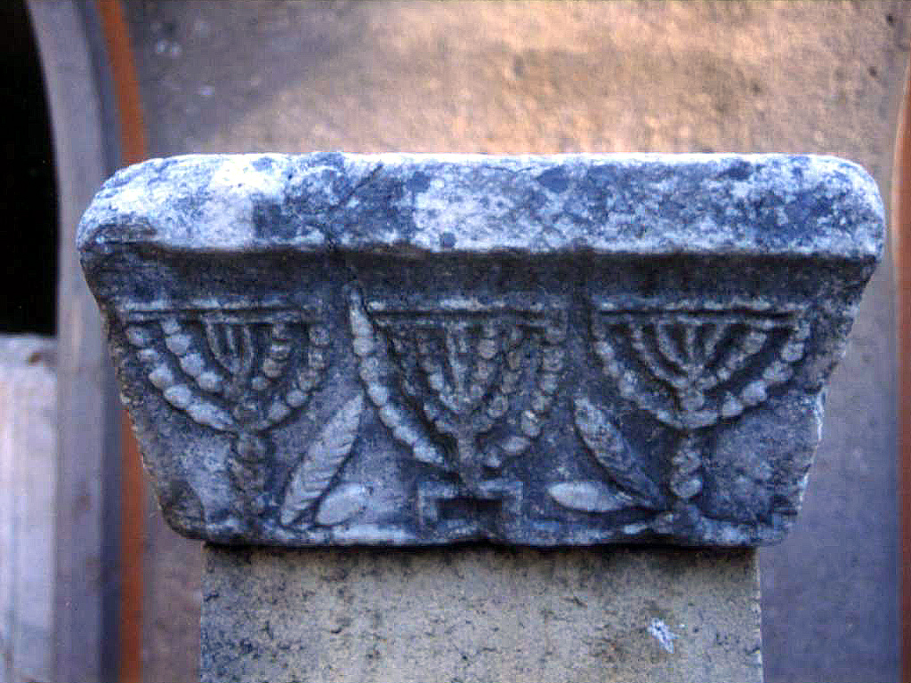
The End

